Slide 1






Latest Cyrcé results and ideas for the next measurements
Measured arrays:
128 x 0.5 x 0.5 mm² array – ‘Array1‘
128 x 0.25 x 0.5 mm² array - ‘Array3‘
Stéphane Higueret, Nico Brosda

Slide 2
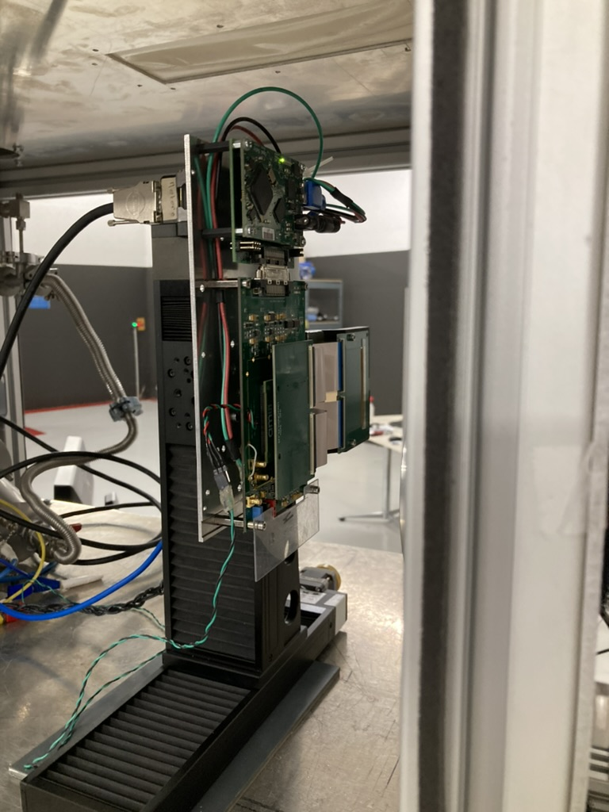
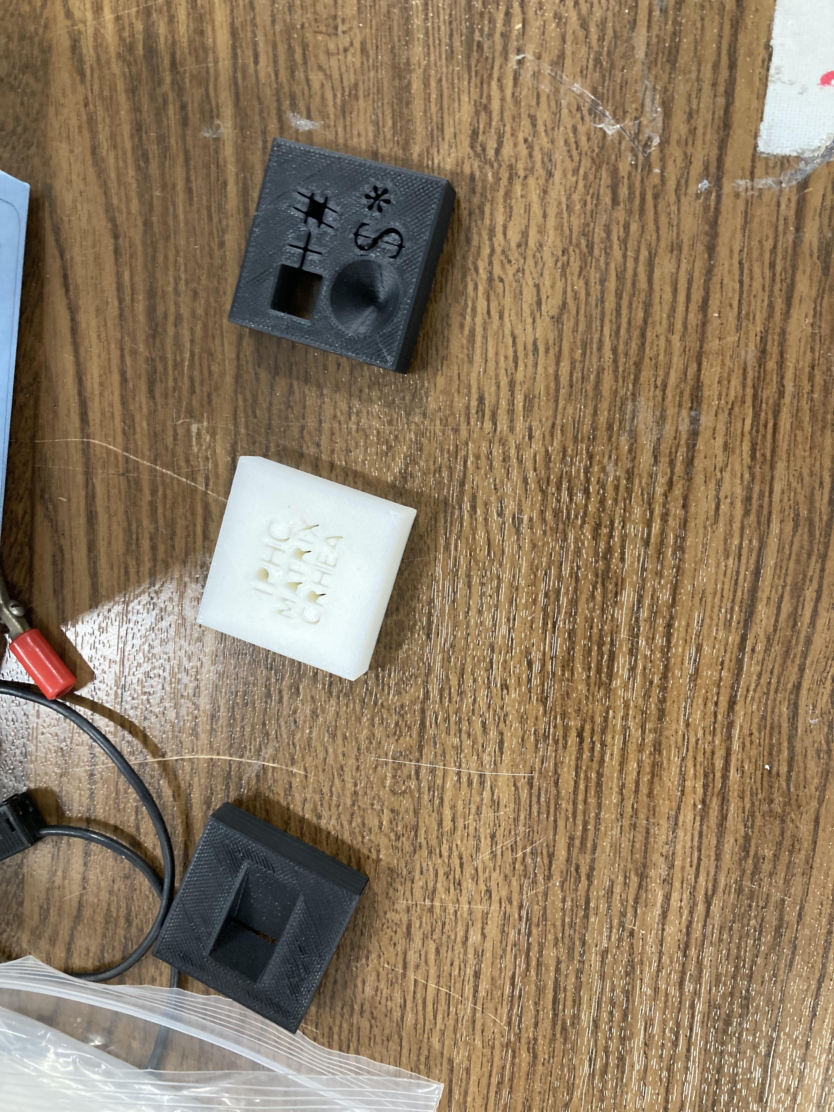
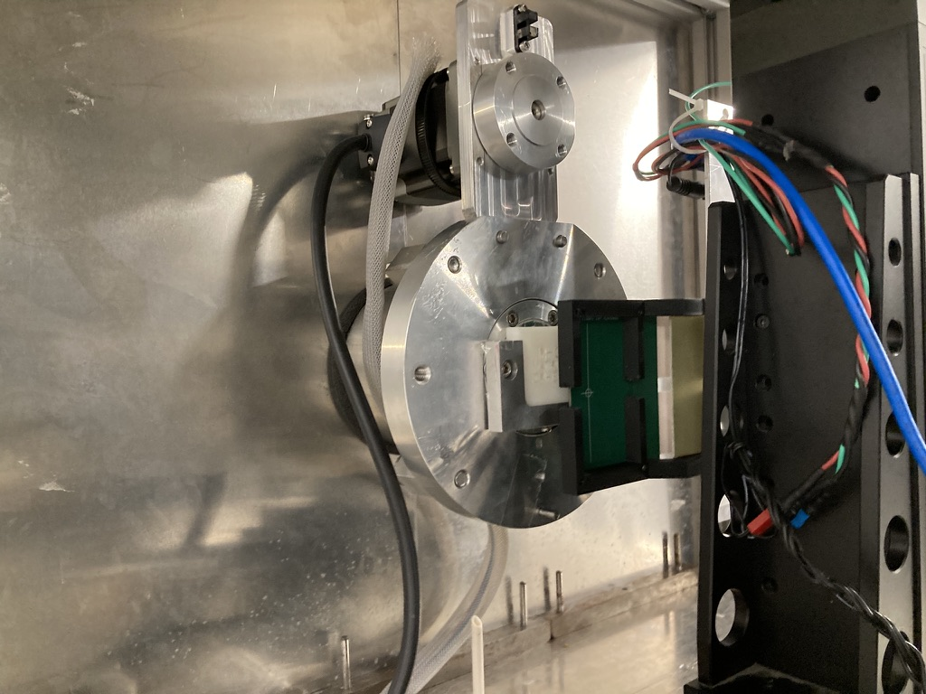
How we measured
Objects to image
Array ~ 128 x 0.5 mm = 64 mm
Mounted on xy - stage
round aperture of
proton beam
ø = (36,51 mm)
~ 30 mm in reality

Slide 3
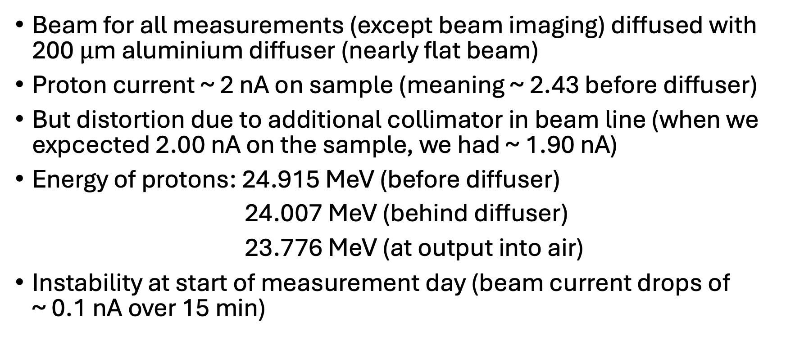
Details about the beam
Beam for all measurements (except beam imaging) diffused with 200 $μ$m aluminium diffuser (nearly flat beam)
Proton current ~ 2 nA on sample (meaning ~ 2.43 before diffuser)
But distortion due to additional collimator in beam line (when we expcected 2.00 nA on the sample, we had ~ 1.90 nA)
Energy of protons: 24.915 MeV (before diffuser)
24.007 MeV (behind diffuser)
23.776 MeV (at output into air)
Instability at start of measurement day (beam current drops of ~ 0.1 nA over 15 min)

Slide 4
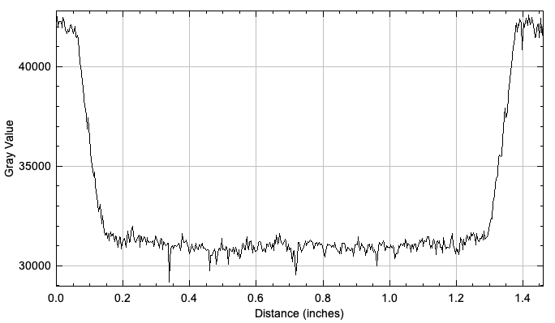
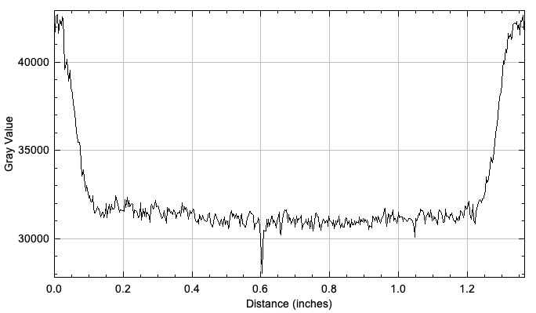
The 200 um diffuser used for these measurements!
H
B
G
D

Slide 5
Samples measured
Active region

Slide 6
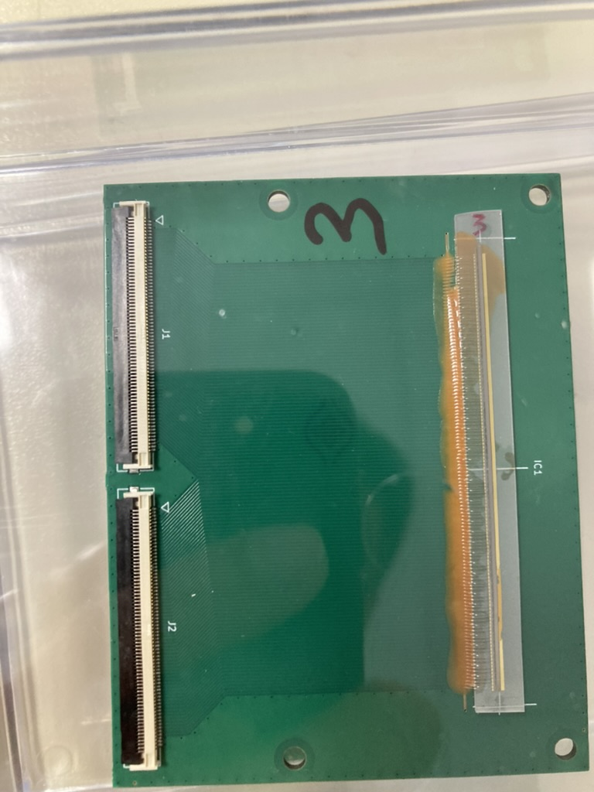
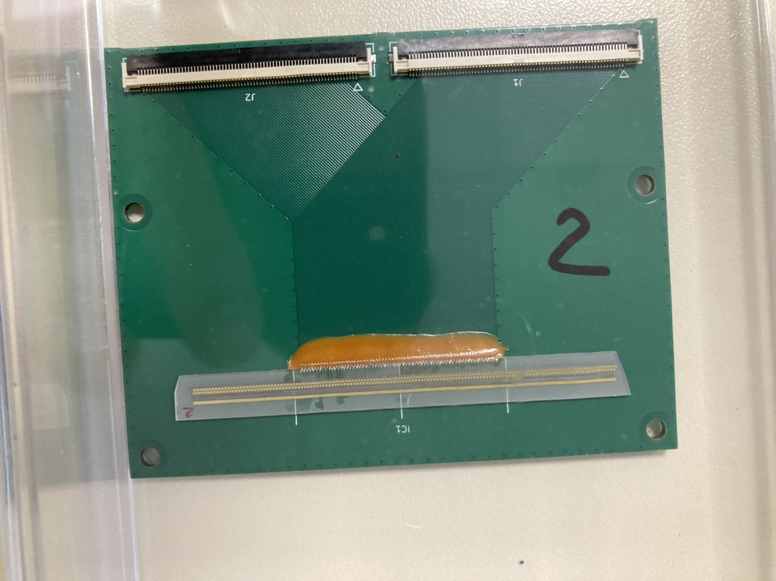
Array 3
Array 2 (not measured yet)

Slide 7
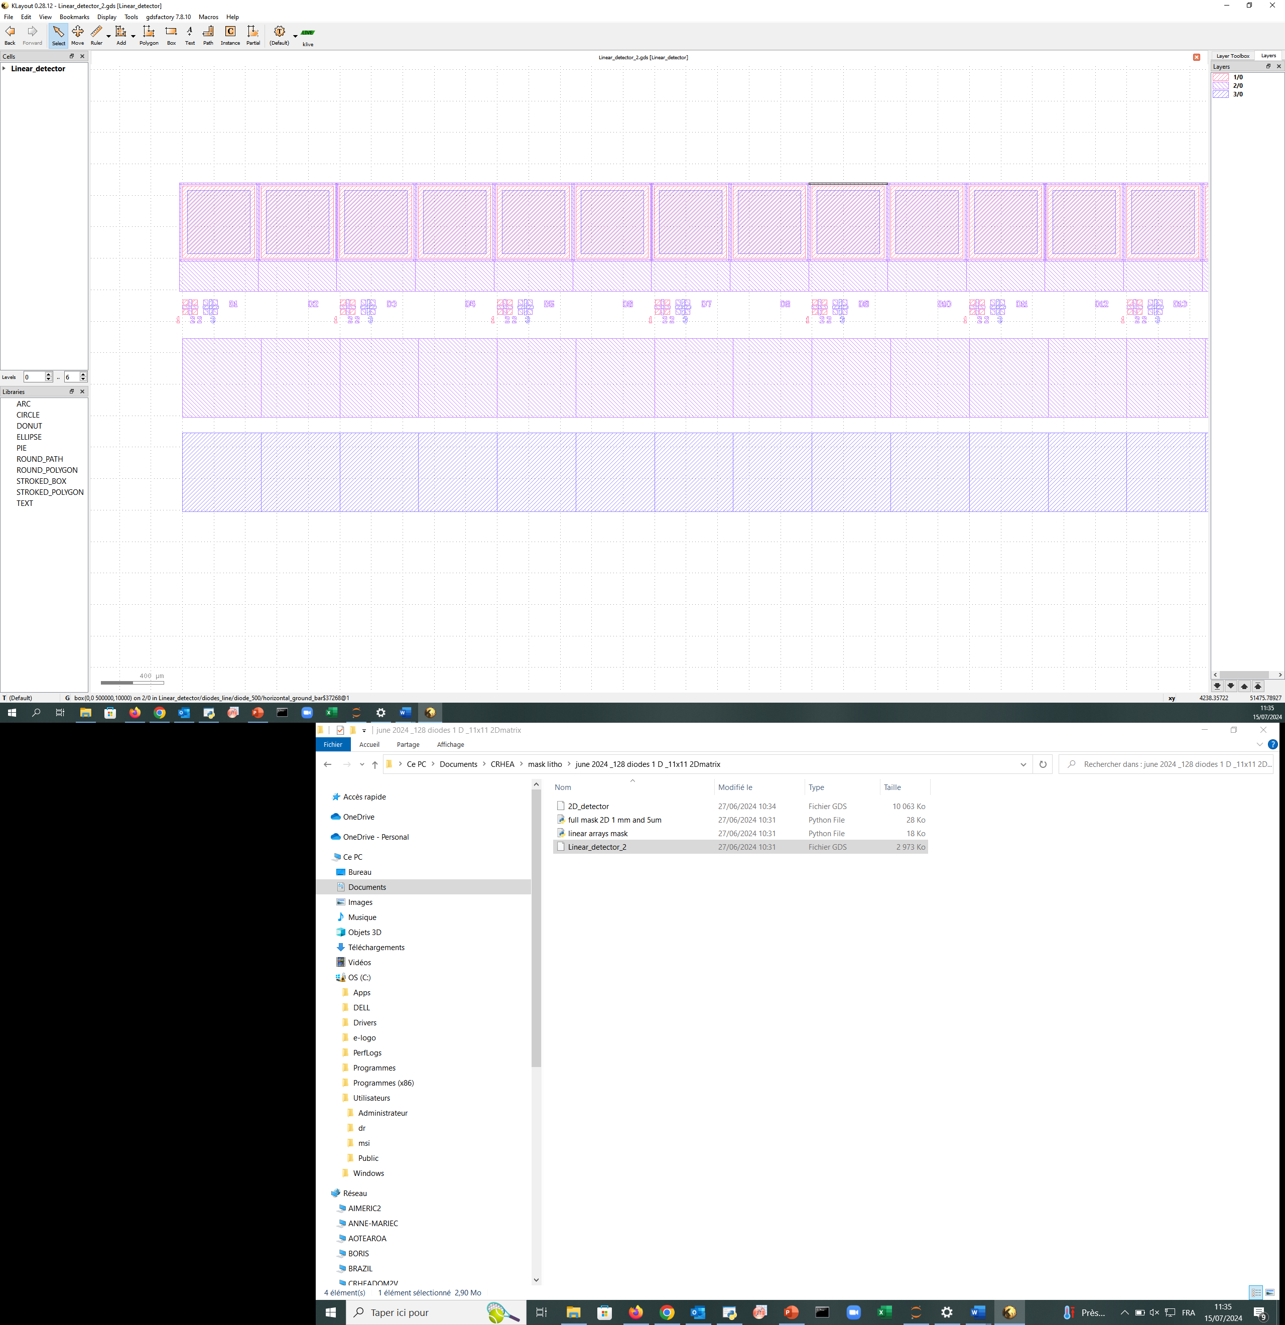
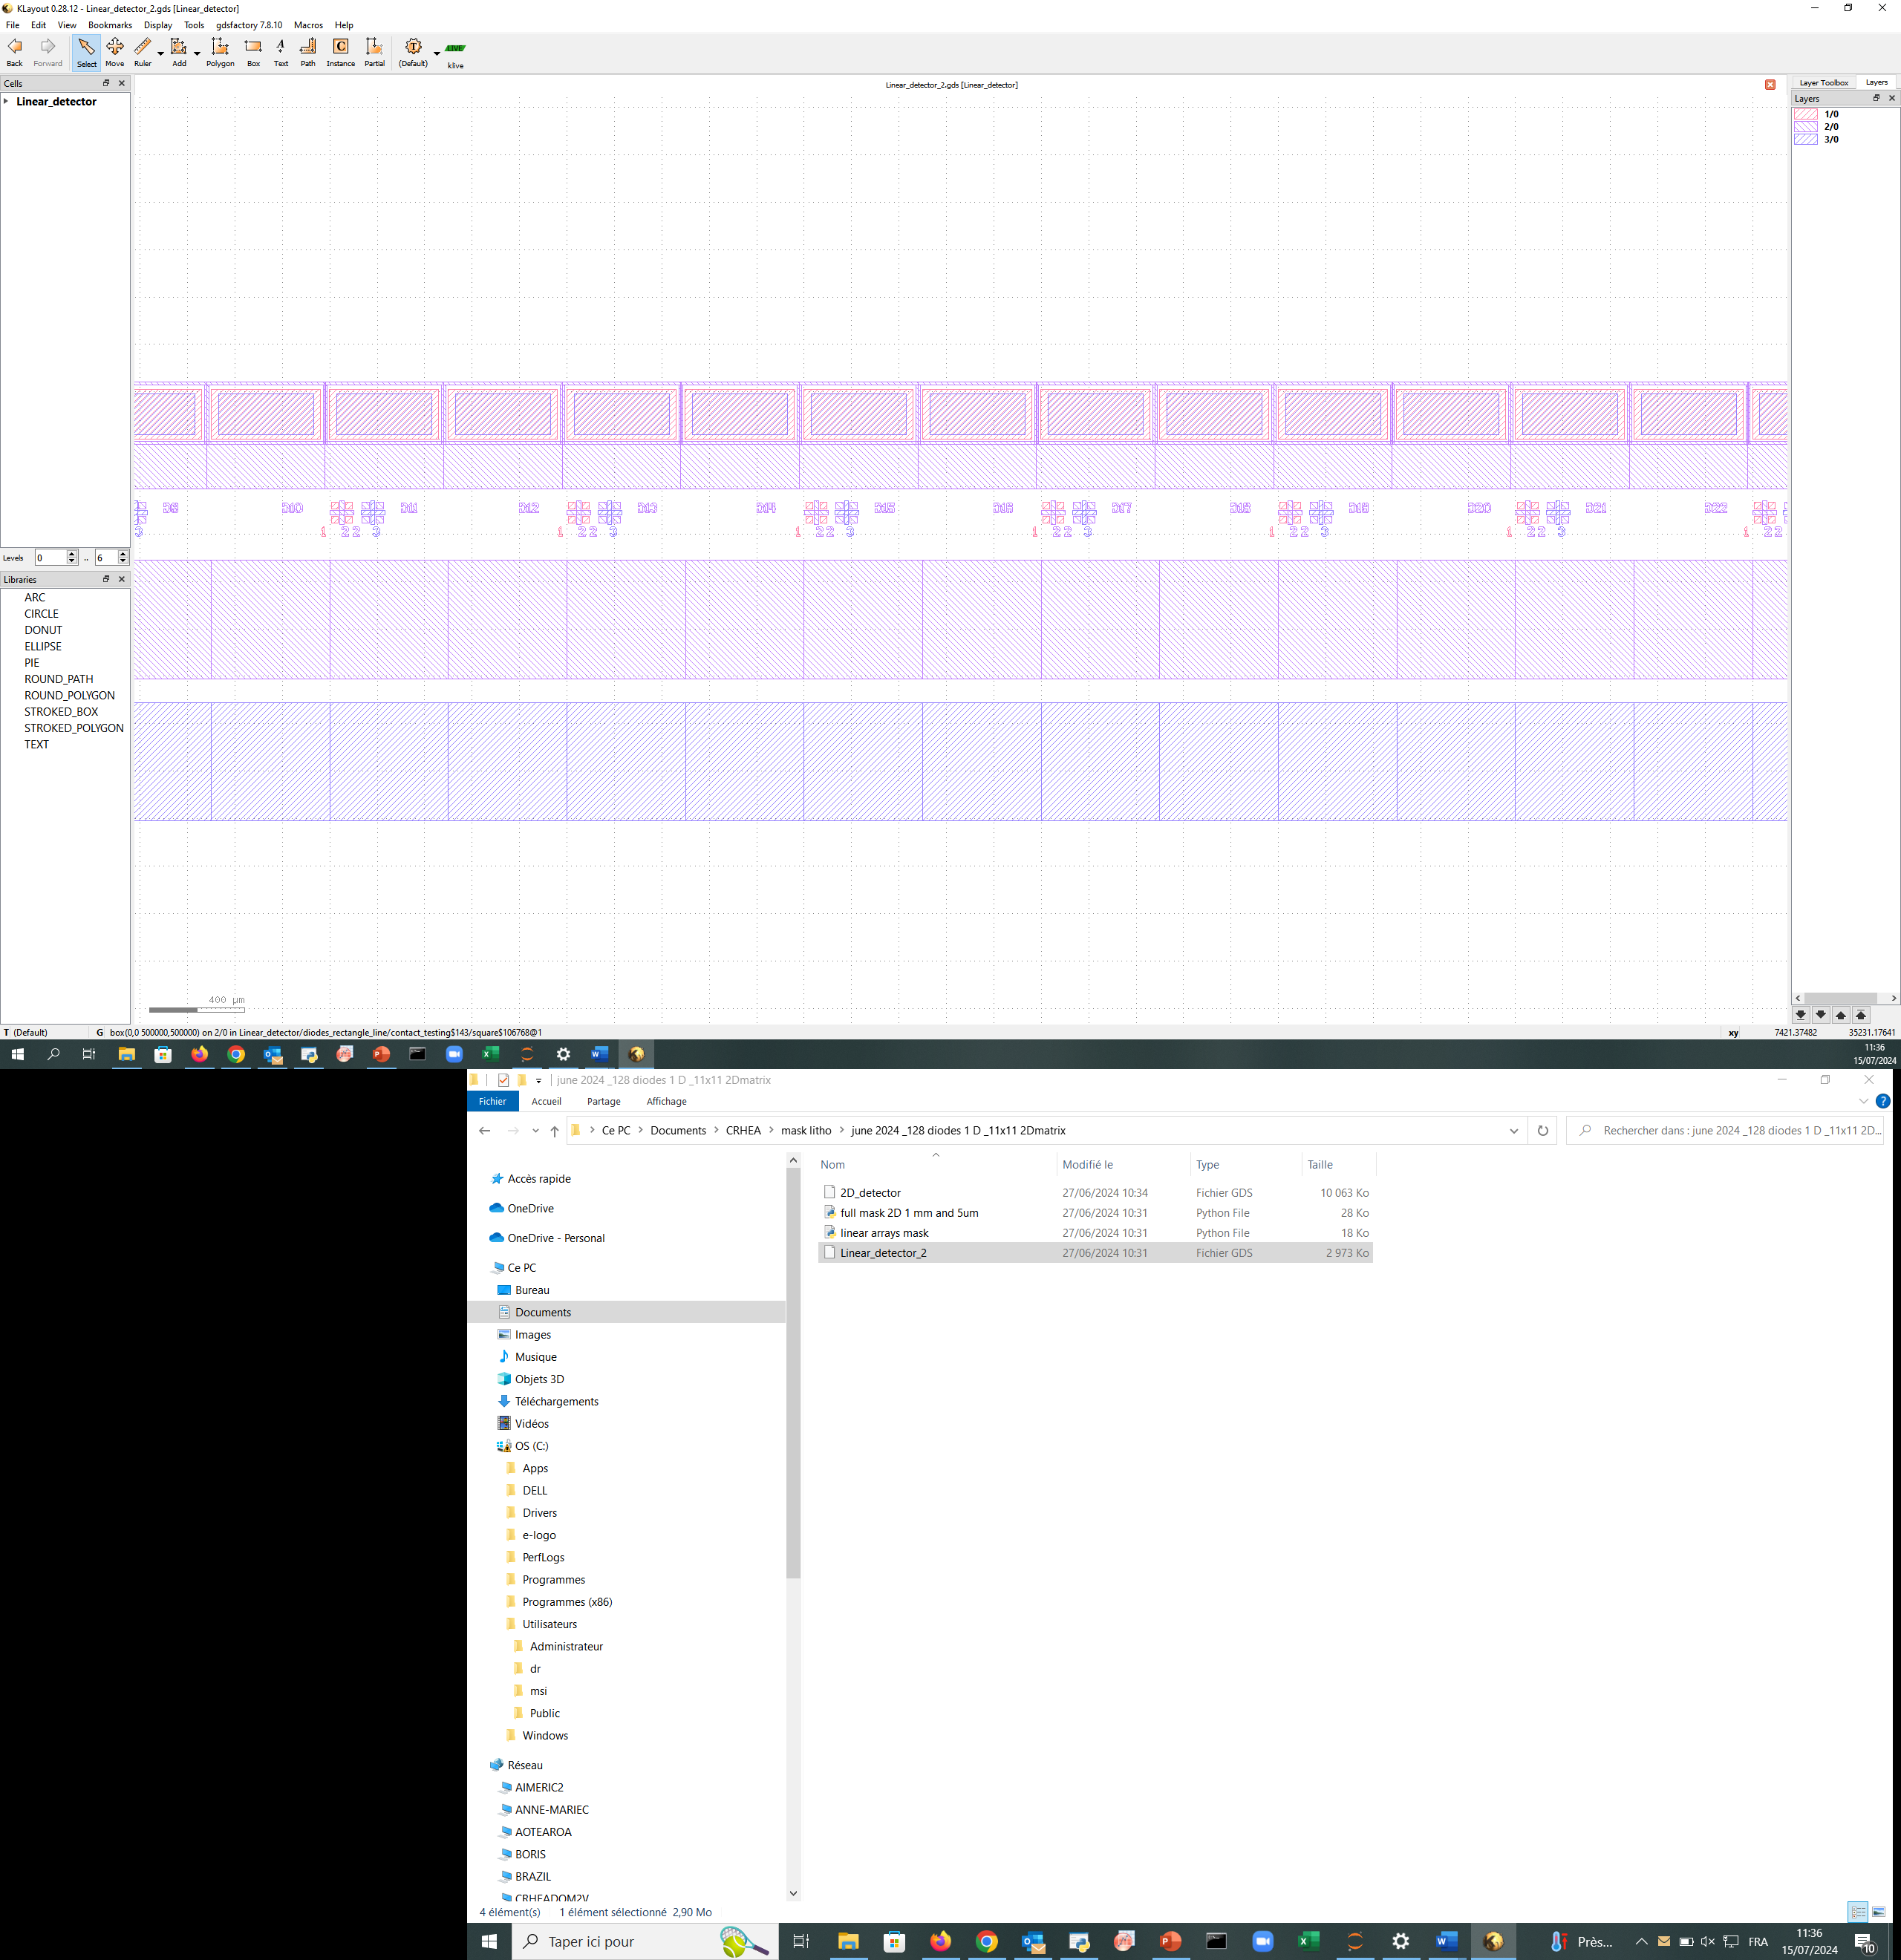
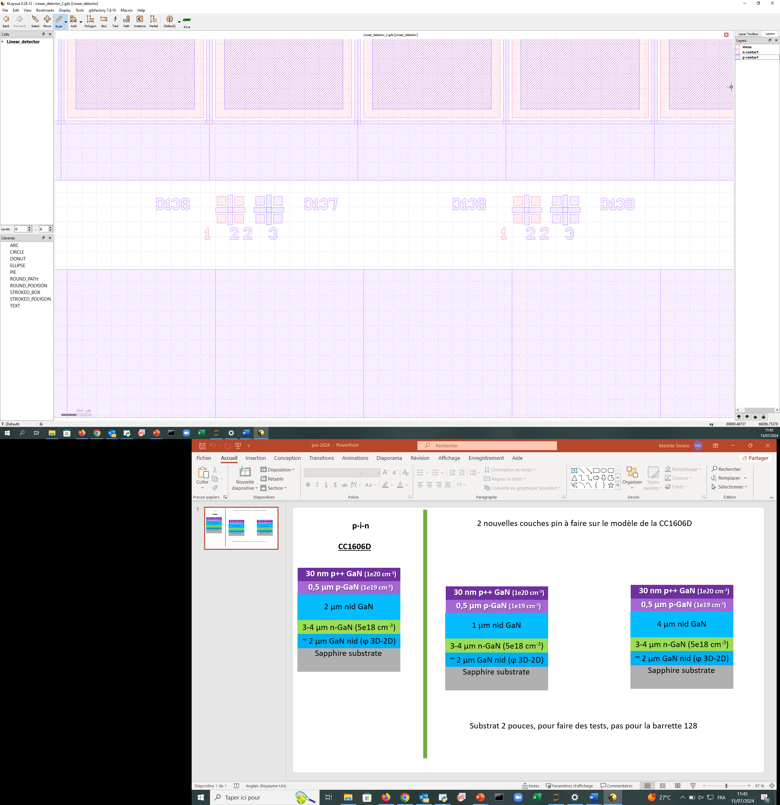
Arrays‘ dimensions
SINGLE DIODE
DIODES LINE (x140)
Maximum total length 500µmx140=7cm
500µm
10µm
Most measurements were done with this array – if not explicitly mentioned the results are from Array1!
400µm
500µm
400µm
20µm
30µm
128 diodes read out – here referred as: Array1
10µm
200µm
SINGLE DIODE
500µm
DIODES LINE (x140)
Maximum total length 500µmx140=7cm
250µm
170µm
400µm
200µm
128 diodes read out – here referred as: Array3

Slide 8
IV-curves

Slide 9
Voltage Scan
From 0 - 2 V for both arrays.
Comparison with old voltage scan
Signal = Mean from measurement
Noise = Std from measurement

Slide 10
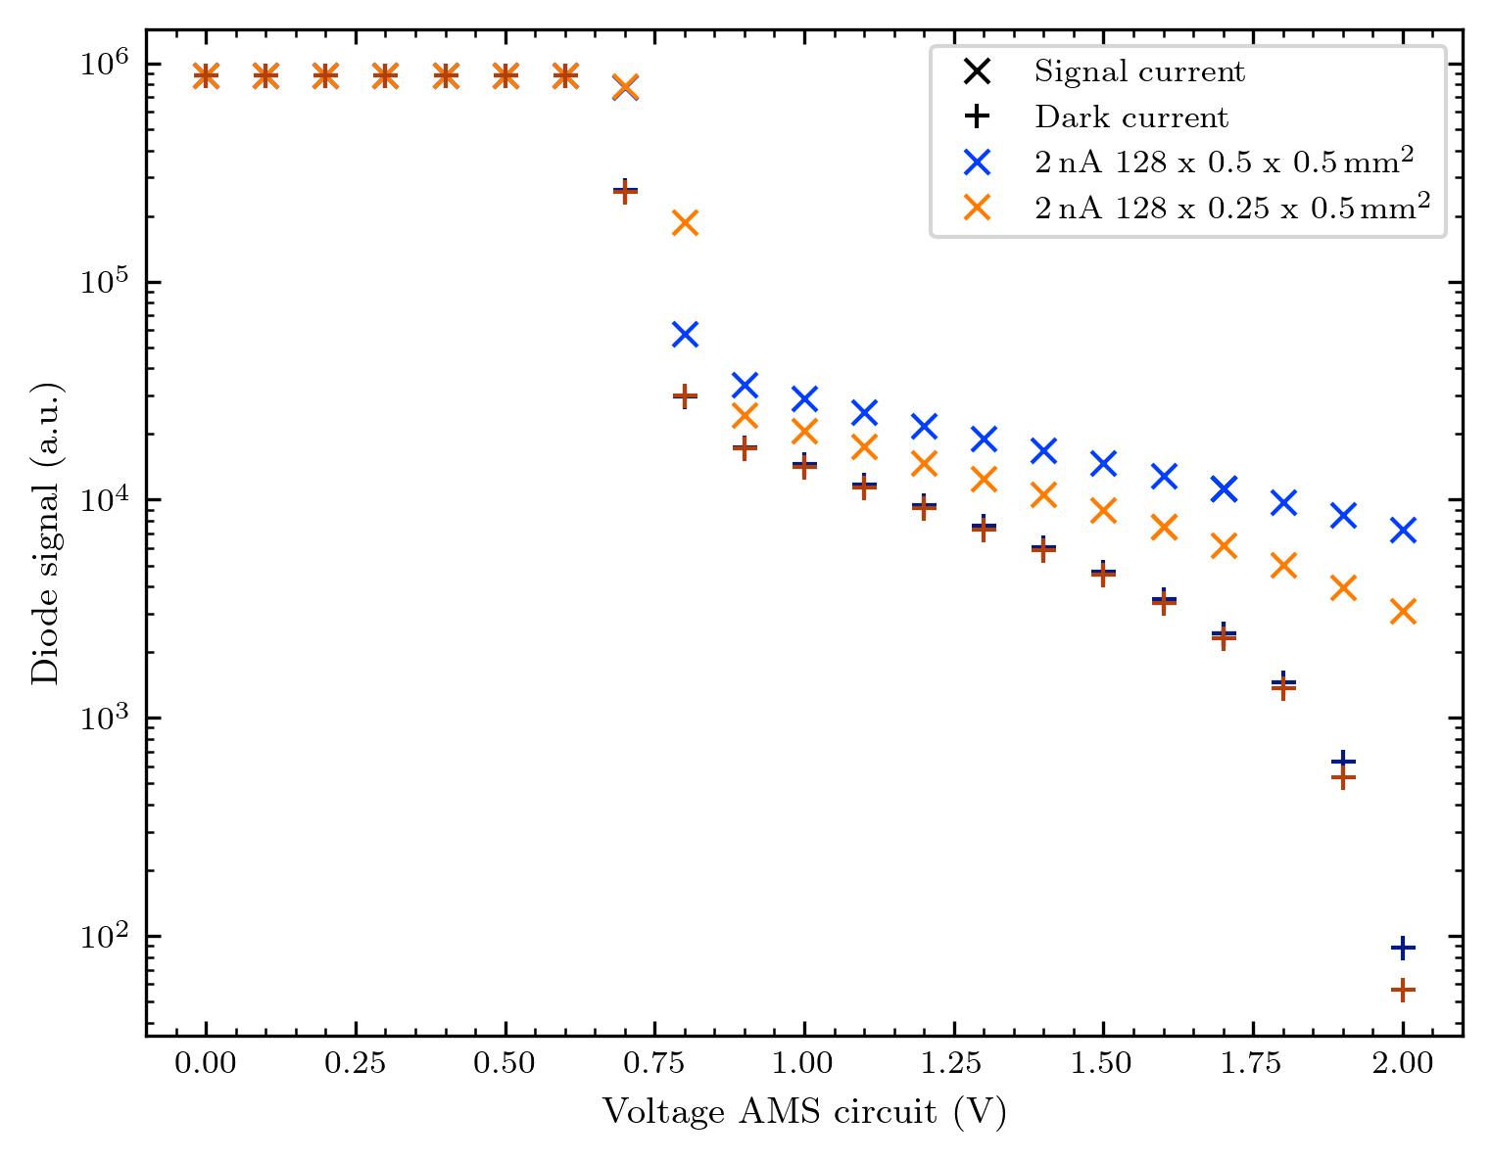
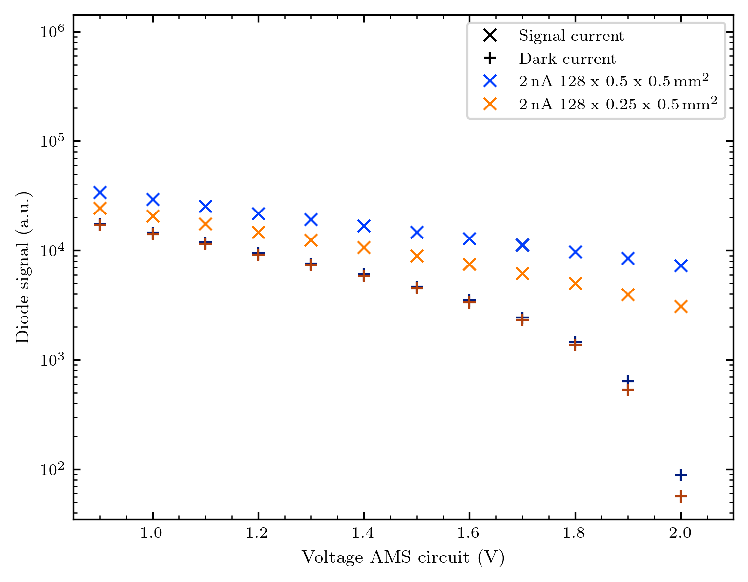
Comparison in one graph

Slide 11
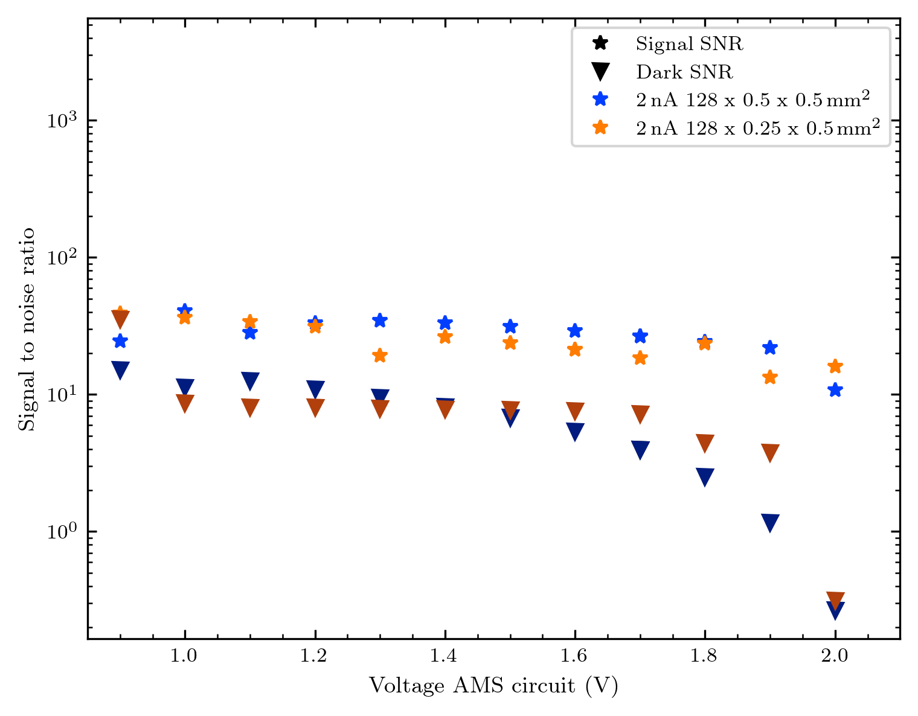
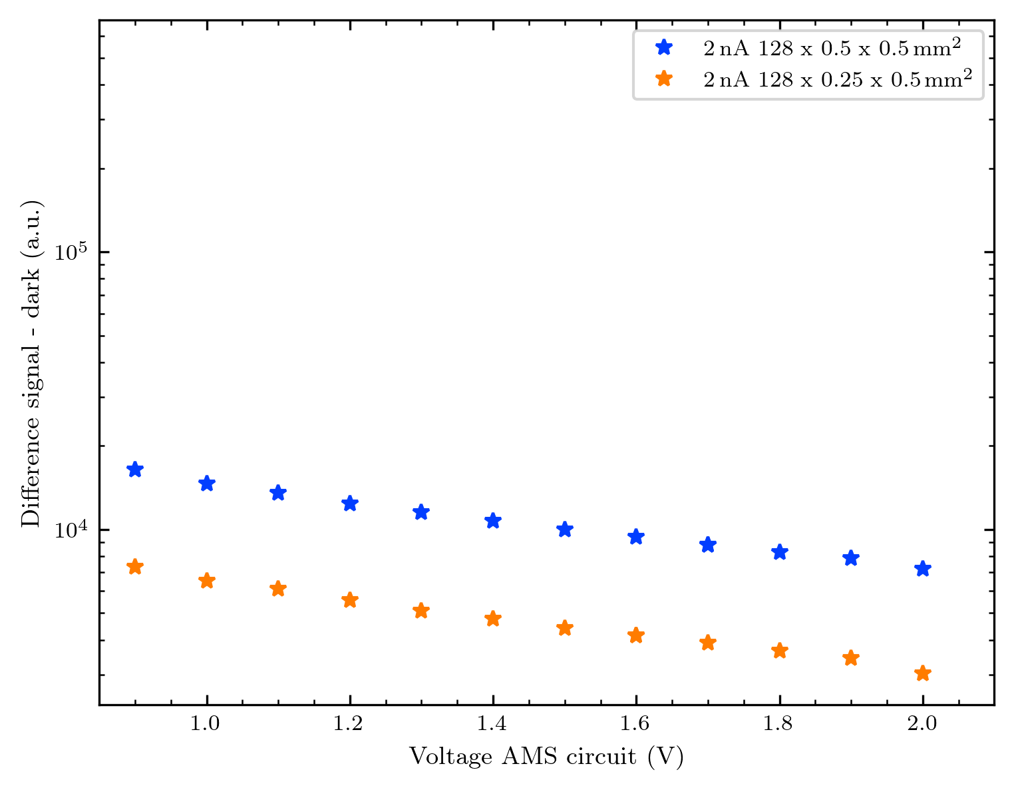
Ratios and netto signal

Slide 12
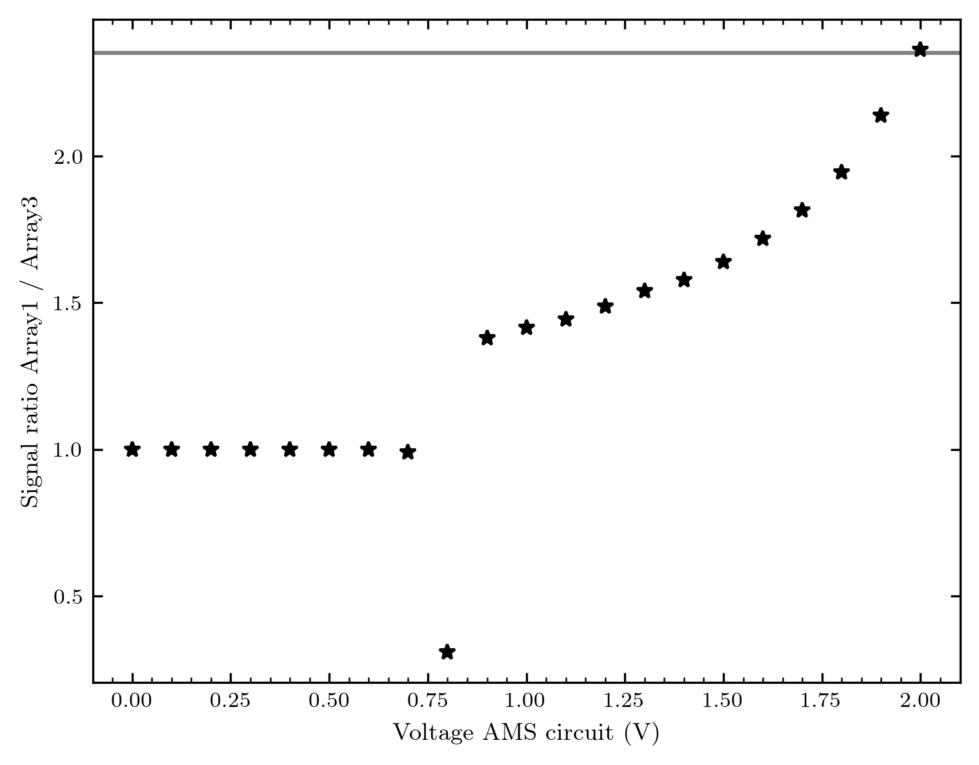
The signal ratio between the 2 array?
We expect a ratio of
0.17 / 0.4 = 2,35
(The diodes have half the size, but the active area
is smaller than the diodes)
Only the 2 V seem the fit this expectation, sadly we cannot see how this trend continues.
There might be some conclusions concerning the effective size of the active area inside the sample!

Slide 13
Images – Array 1

Slide 14
Image raw vs background subtracted

Slide 15
Fanout (old) vs direct bond (new)

Slide 16
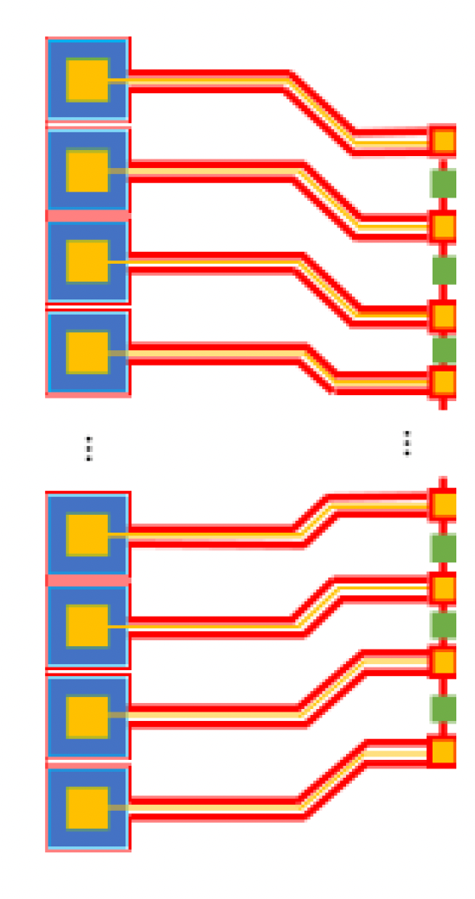
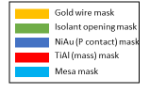
The difference in concept
Previous 64 diode arrays
Masks of new array generation – no fanout on GaN sample, direct bonding to PCB

Slide 17
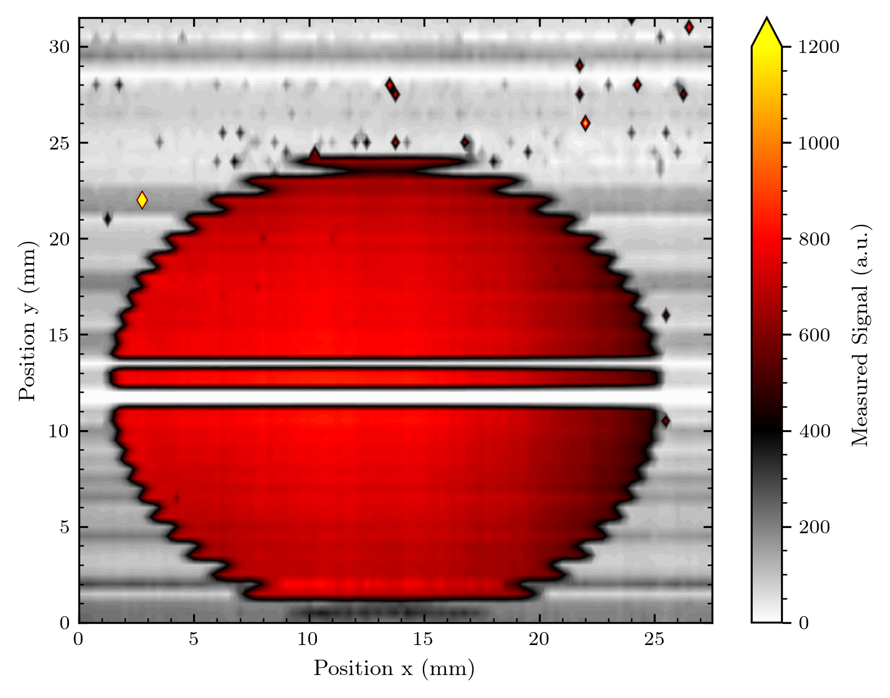
Round aperture

Slide 18
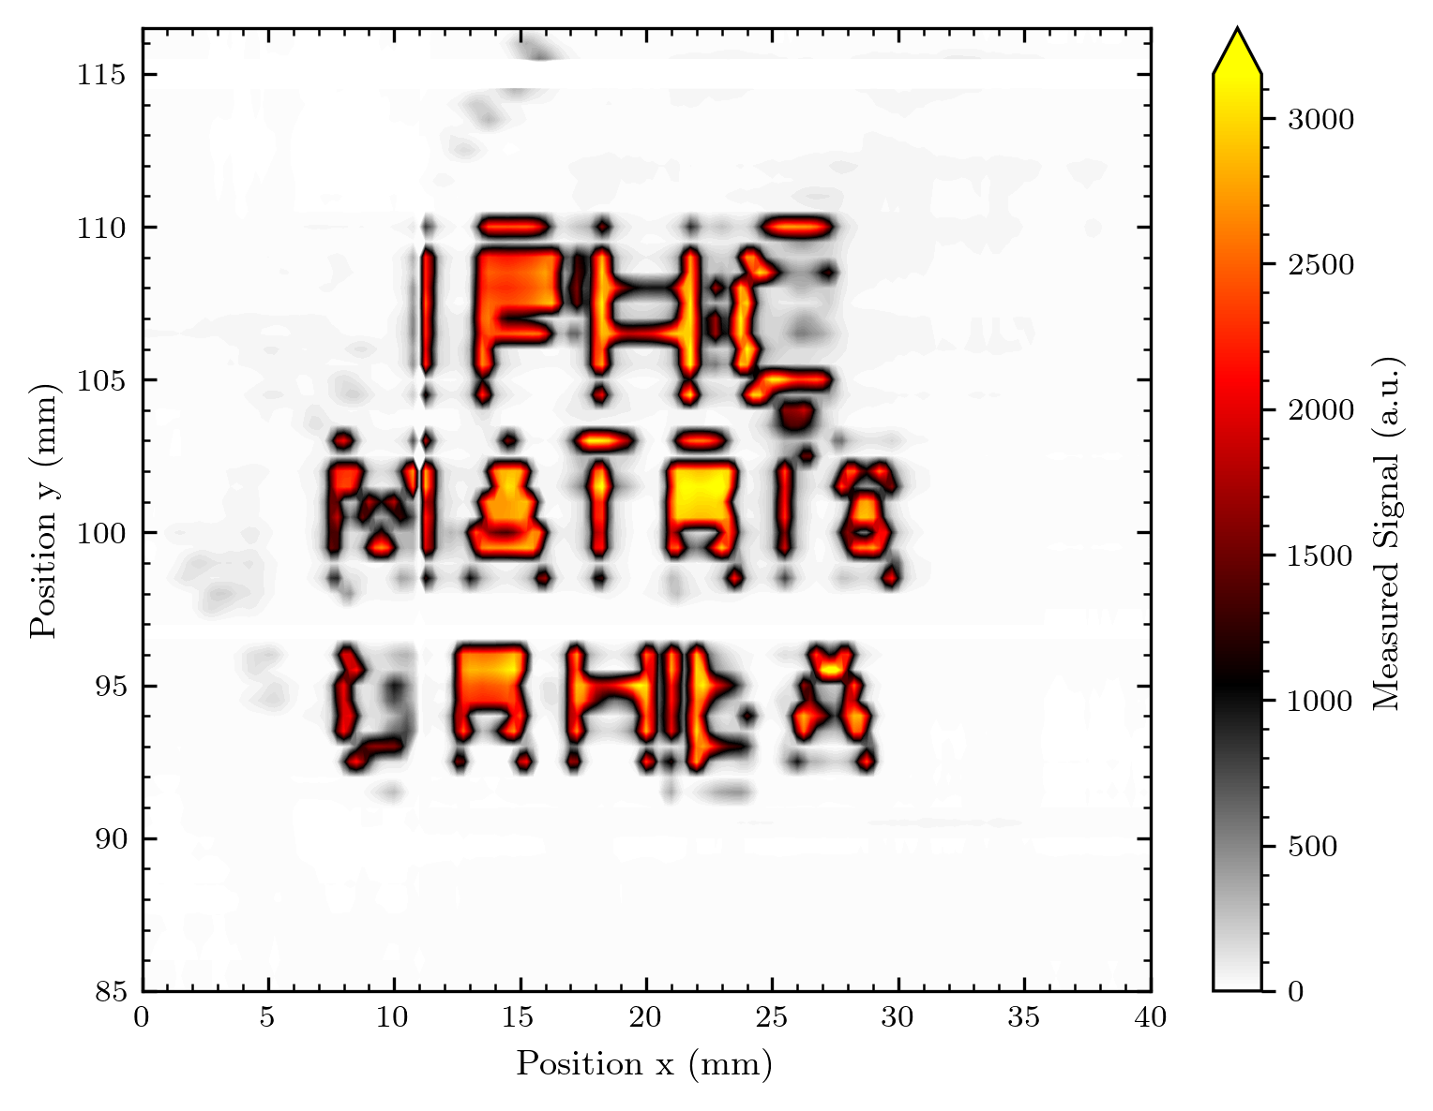
Logo

Slide 19
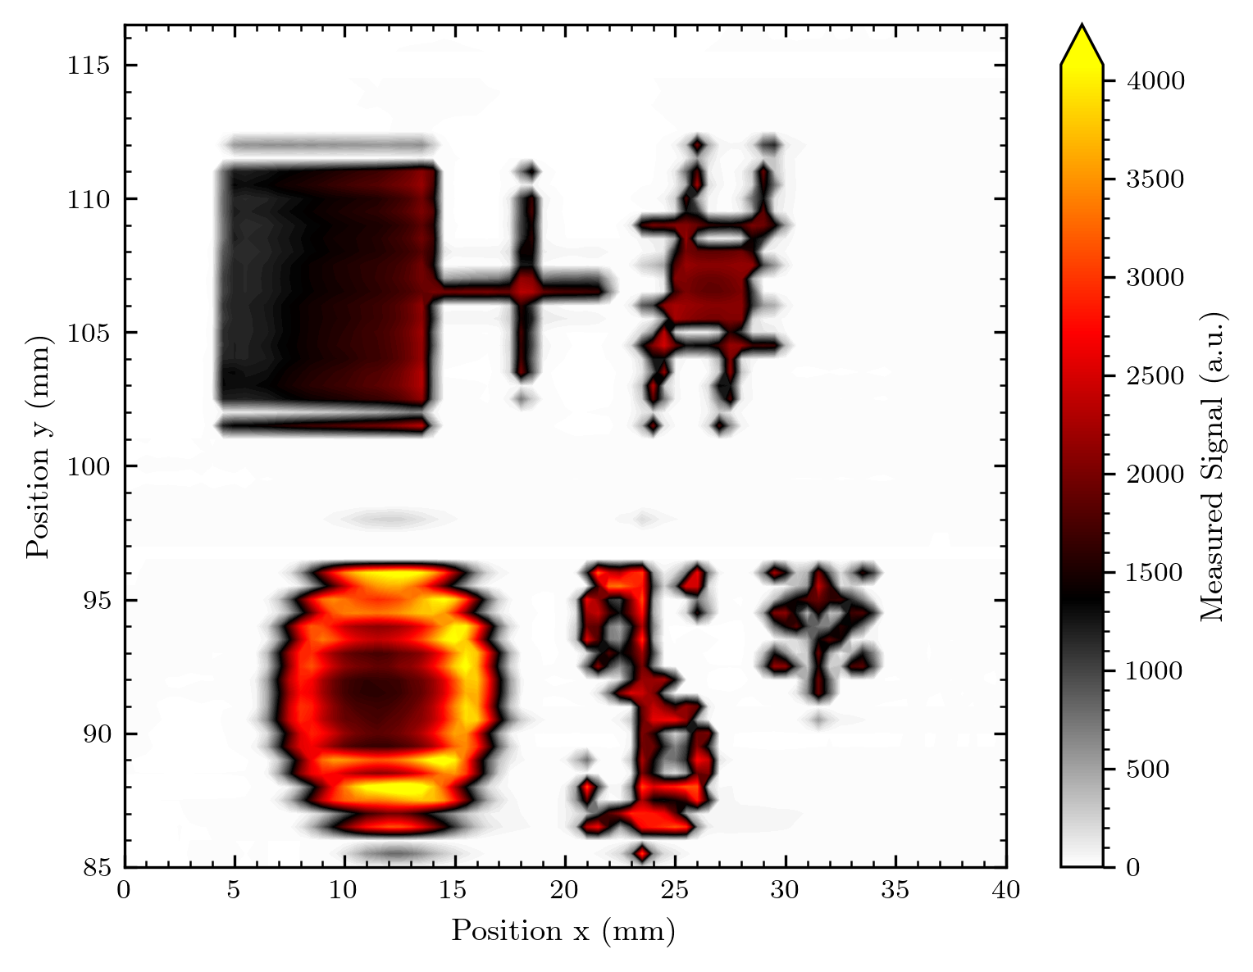
Misc shape

Slide 20
Results y-translated measurements
What was measured?
How uniform are the diodes?
How good is the normalisation factor?
Comparison to factor from the previous measurement

Slide 21
What was measured?
Every diode is measured at several (overlapping) positions in the beam

Slide 22
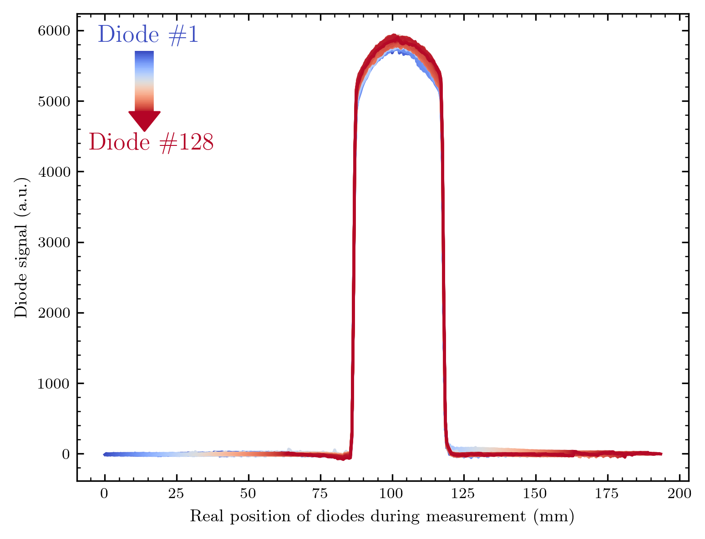
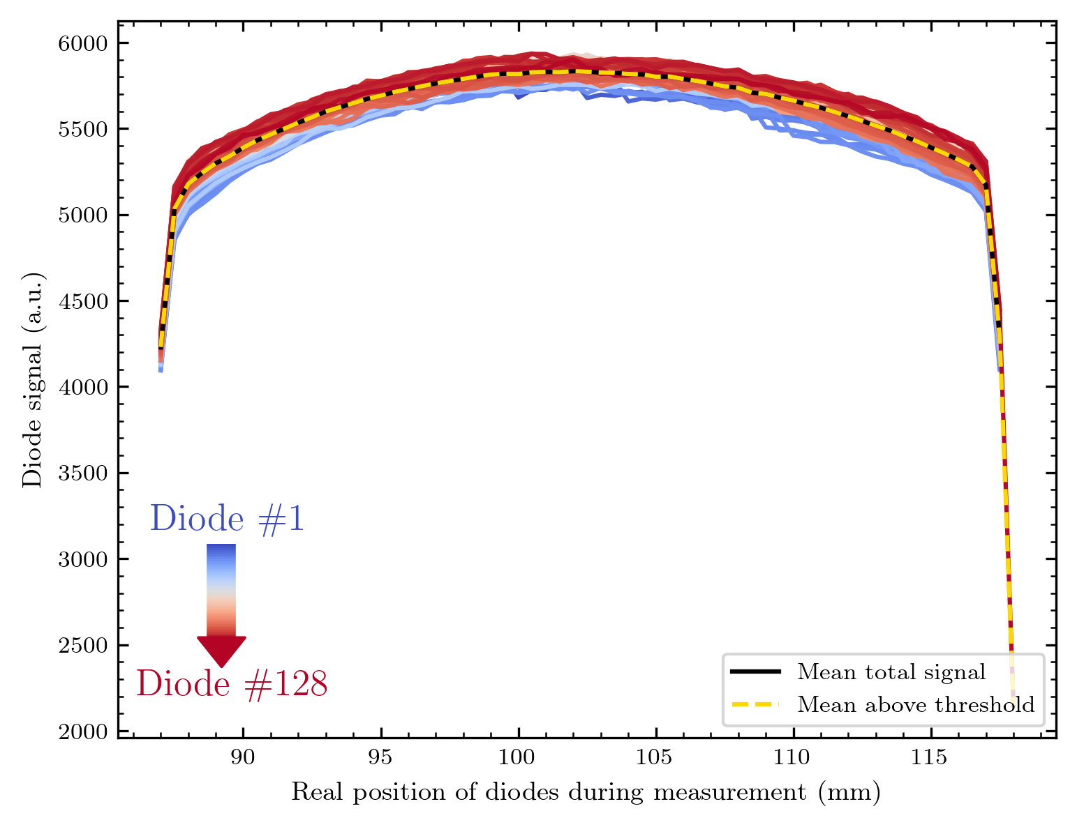
Scan begin of beam time (decreased current?)

Slide 23
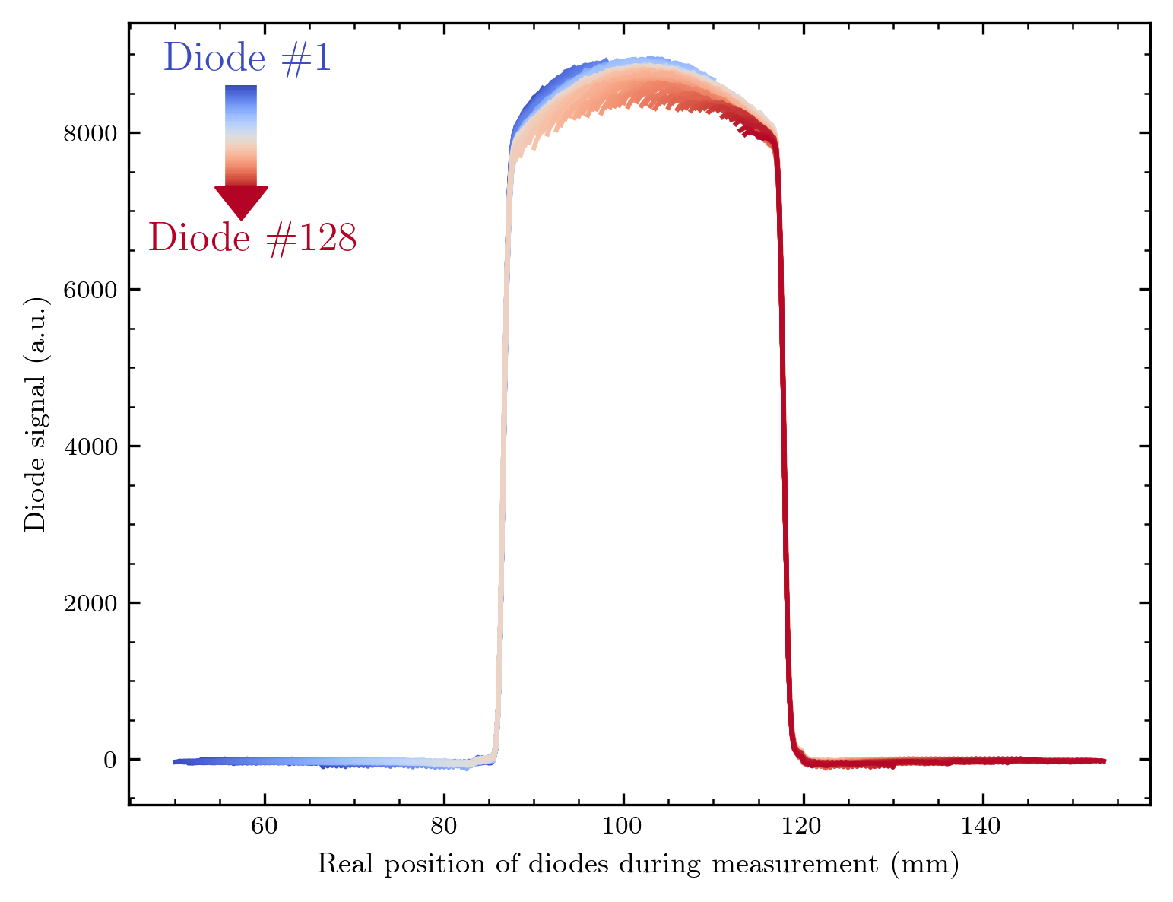
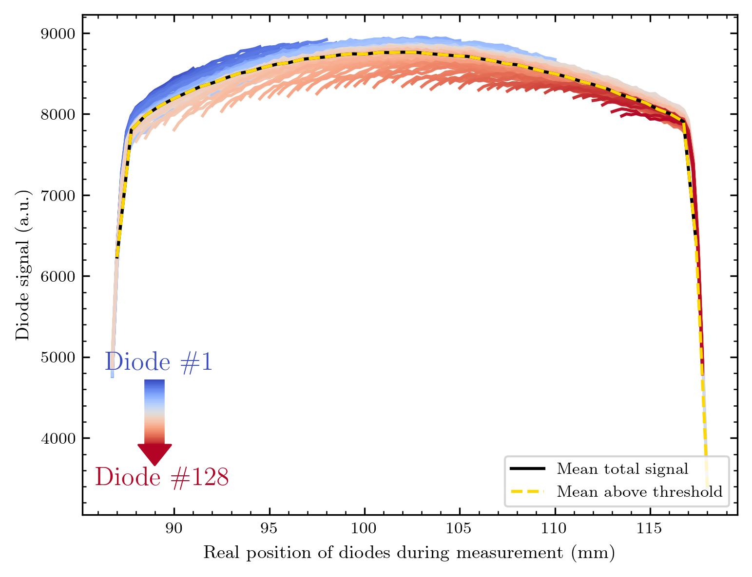
Scan with more stable current?

Slide 24
Comparison
In both cases we scanned upwards, meaning each diode's signal on the left was measured first, the one for high y-values (on the x-axis) later on.
The signal is indeed lower for the left scan, which would correspond to the lower beam current. Maybe the beam current dropped after starting the scan and remained nearly constant?
Could we see degradation effects on the right side?

Slide 25
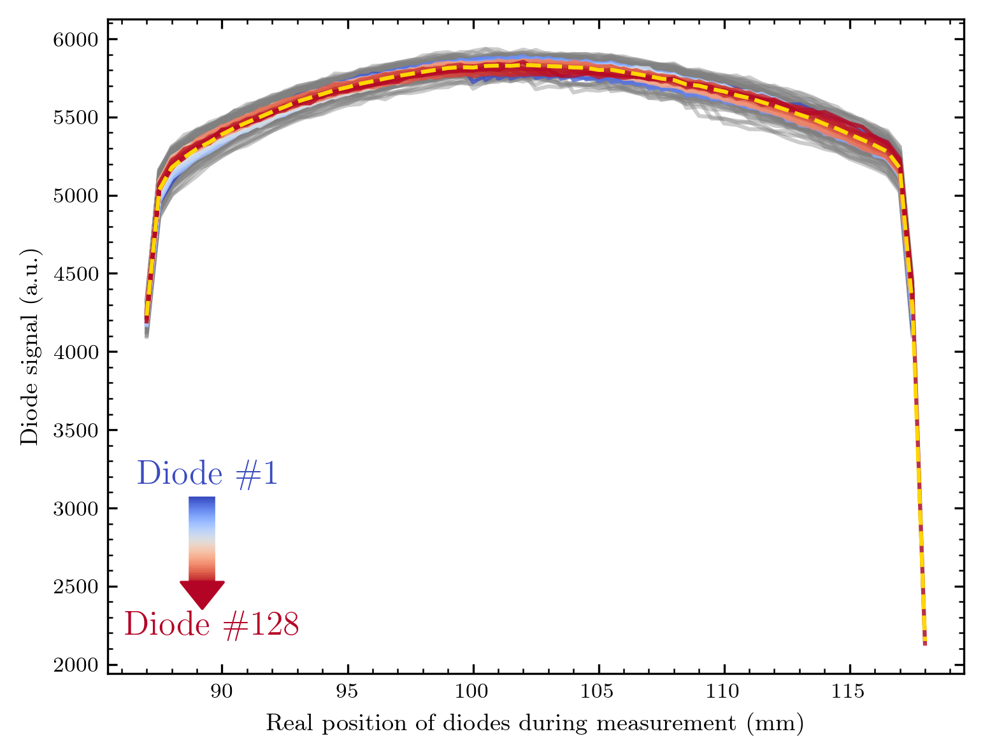
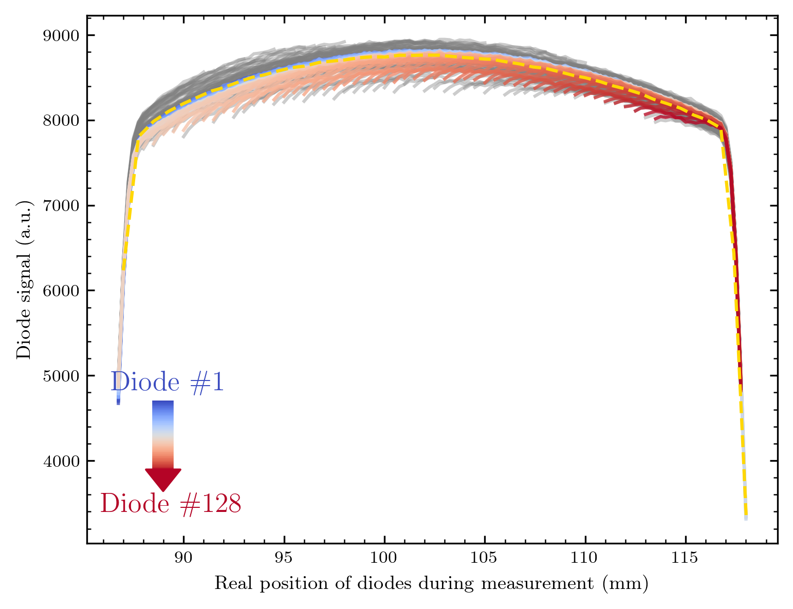
I calculate a factor for both of these and shift the diodes‘ curves correspondingly

Slide 26
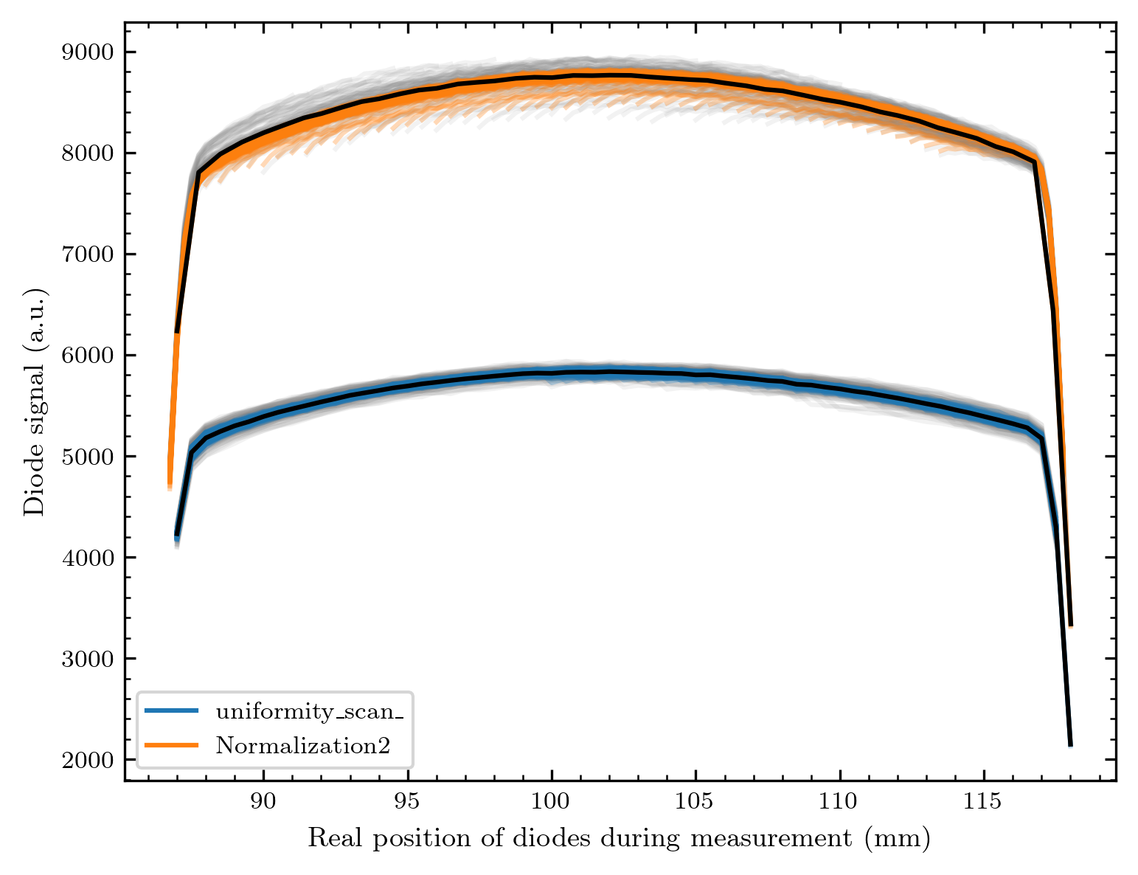
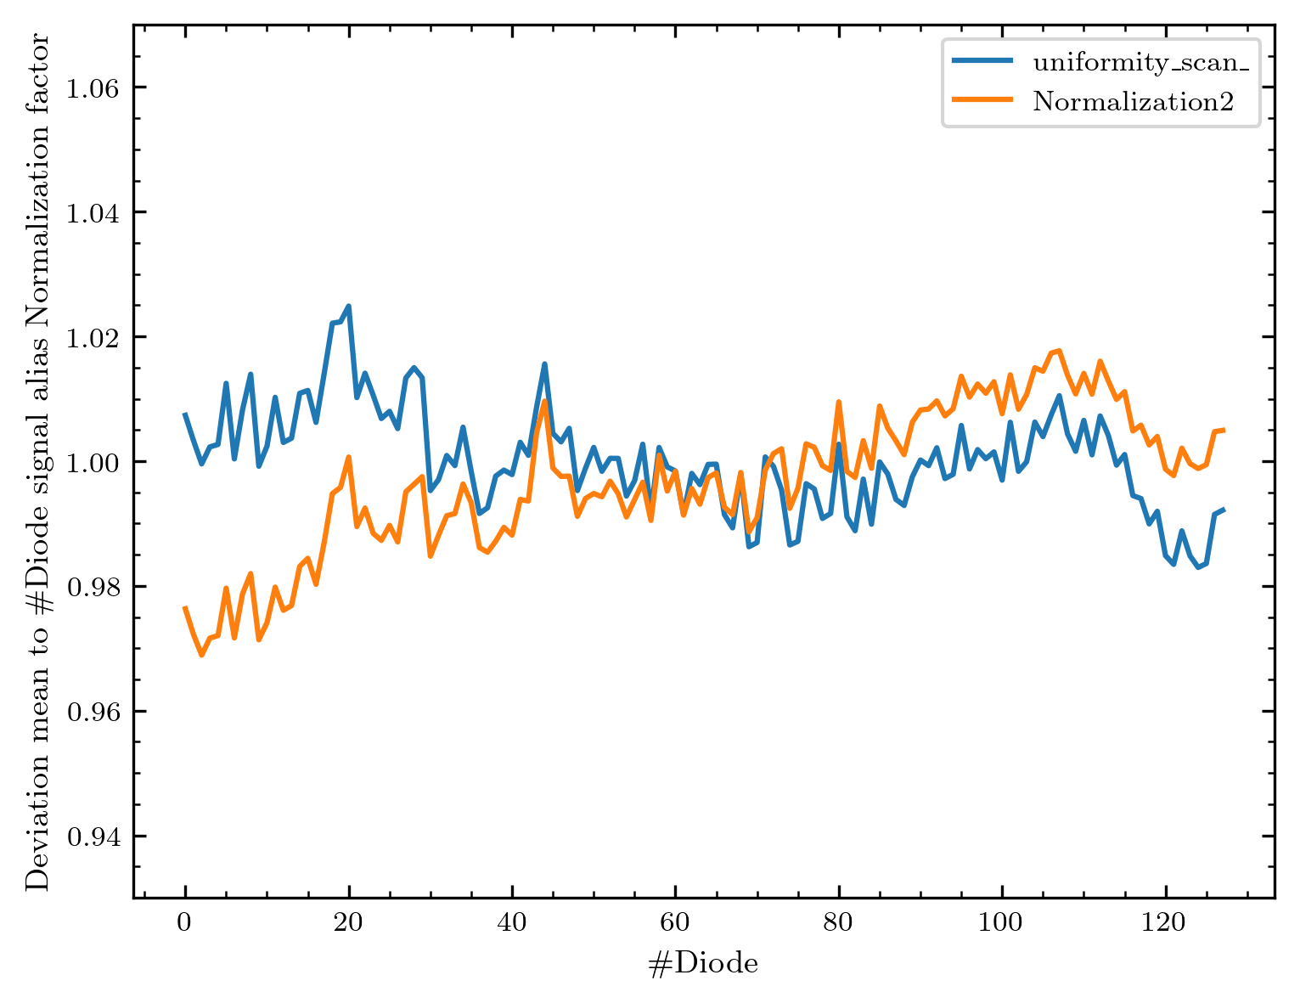
Factors and comparison
We are, in each case, inside ~ 6 % homogeneity in the response!
There is a difference between the 2 normalization measurements, but some parts of the factor are identical – this is also nice proof of the stability in the diode response.

Slide 27
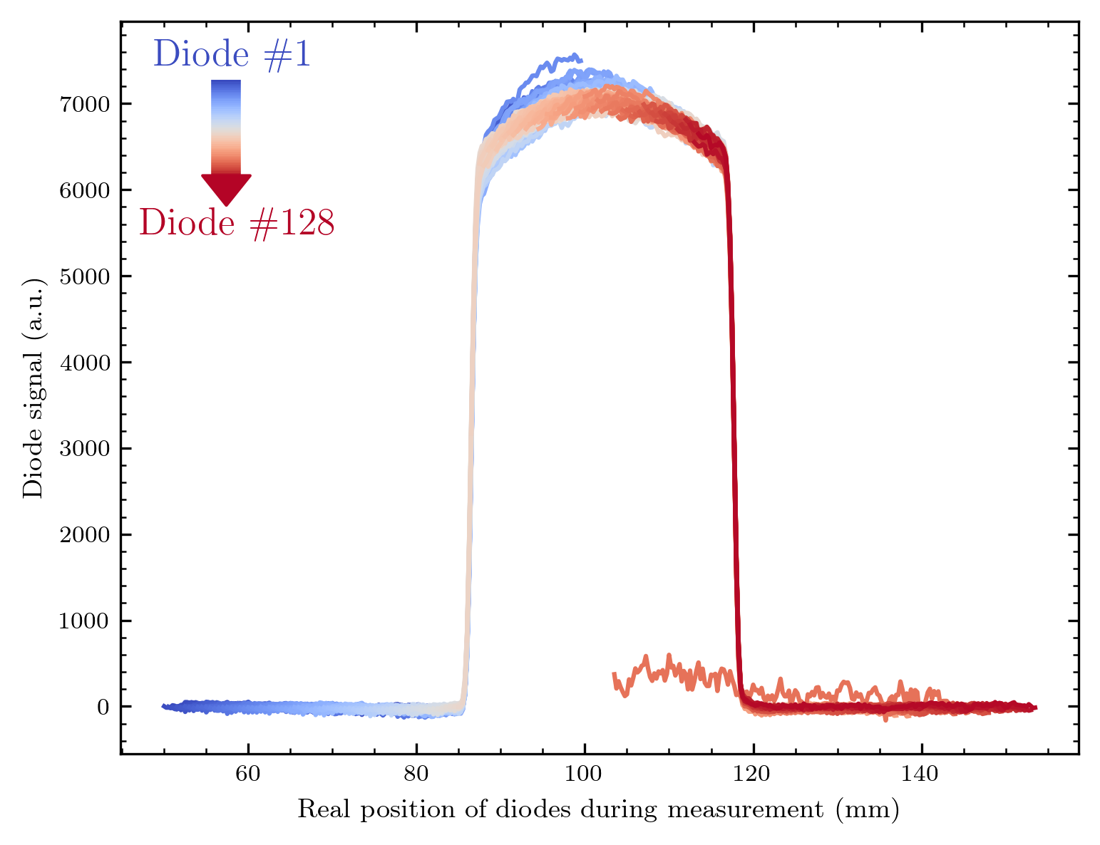
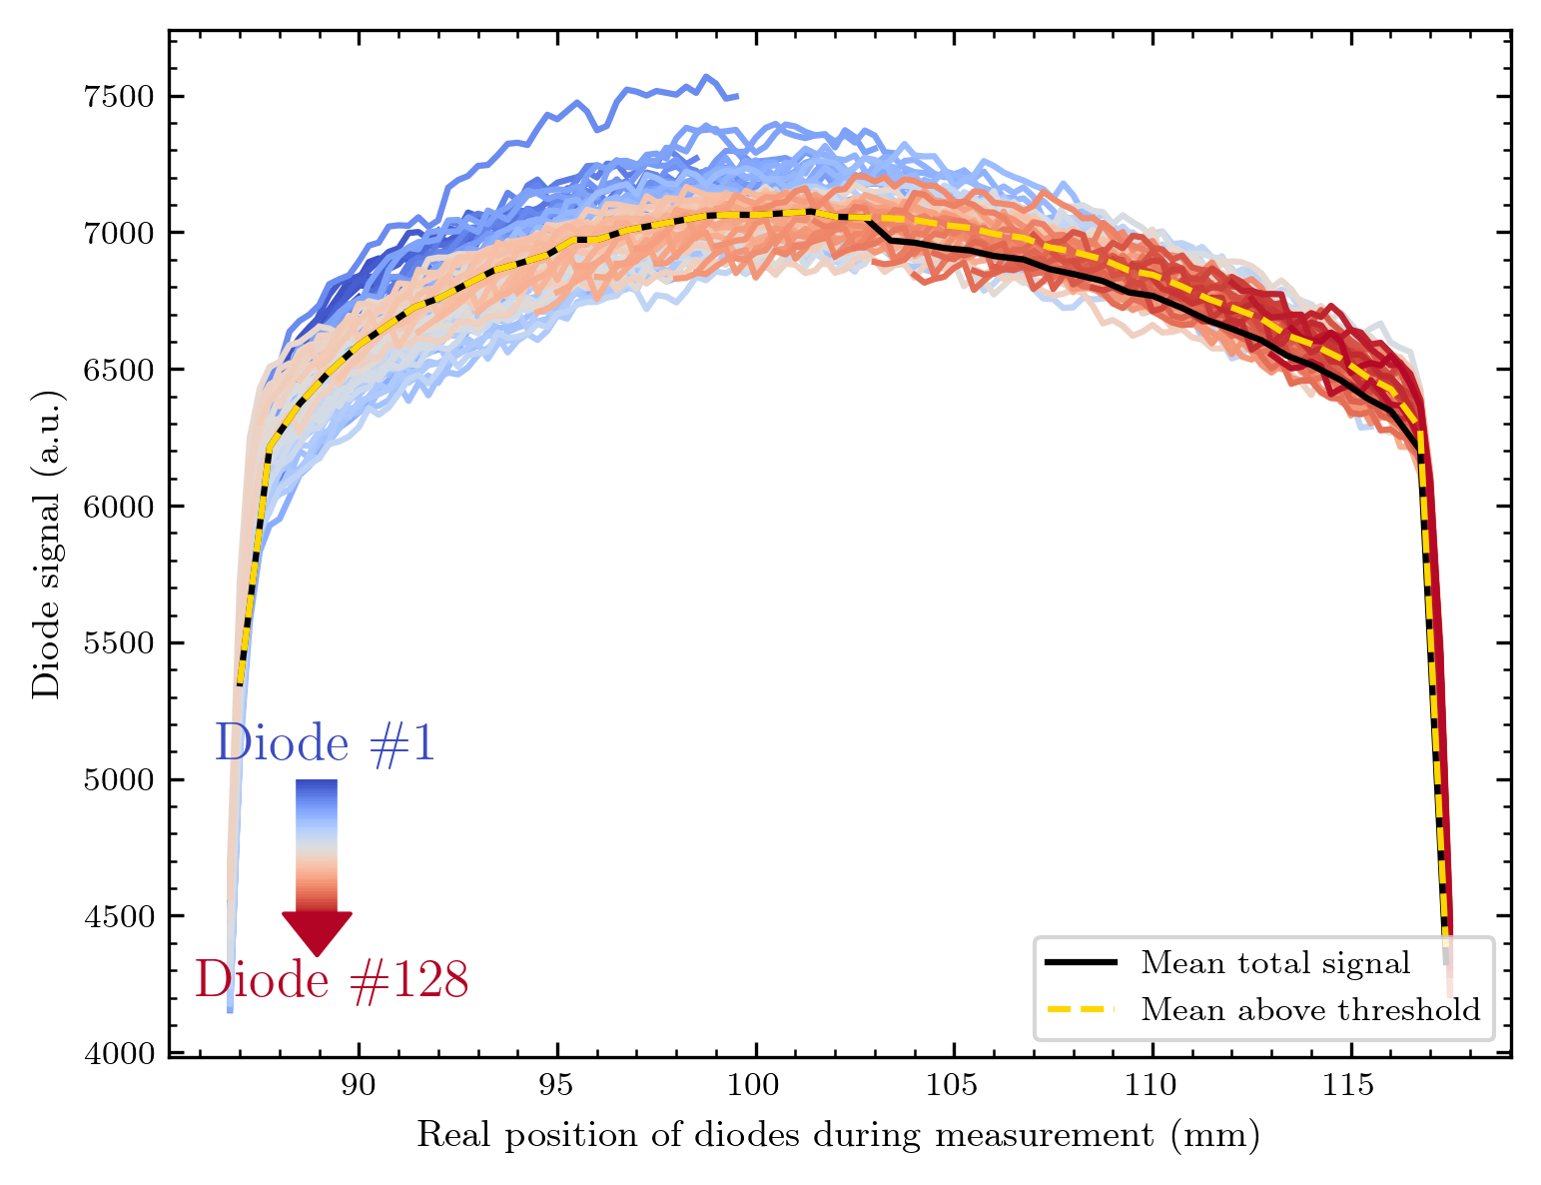
Scan Array 3; also stable current – different voltage setpoint
Also, very homogeneous, maybe a bit worse than the other array? Here is one not working diode – the only one of both arrays. This means the fabrication reached an efficiency of ~ 99,6 % ☺

Slide 28
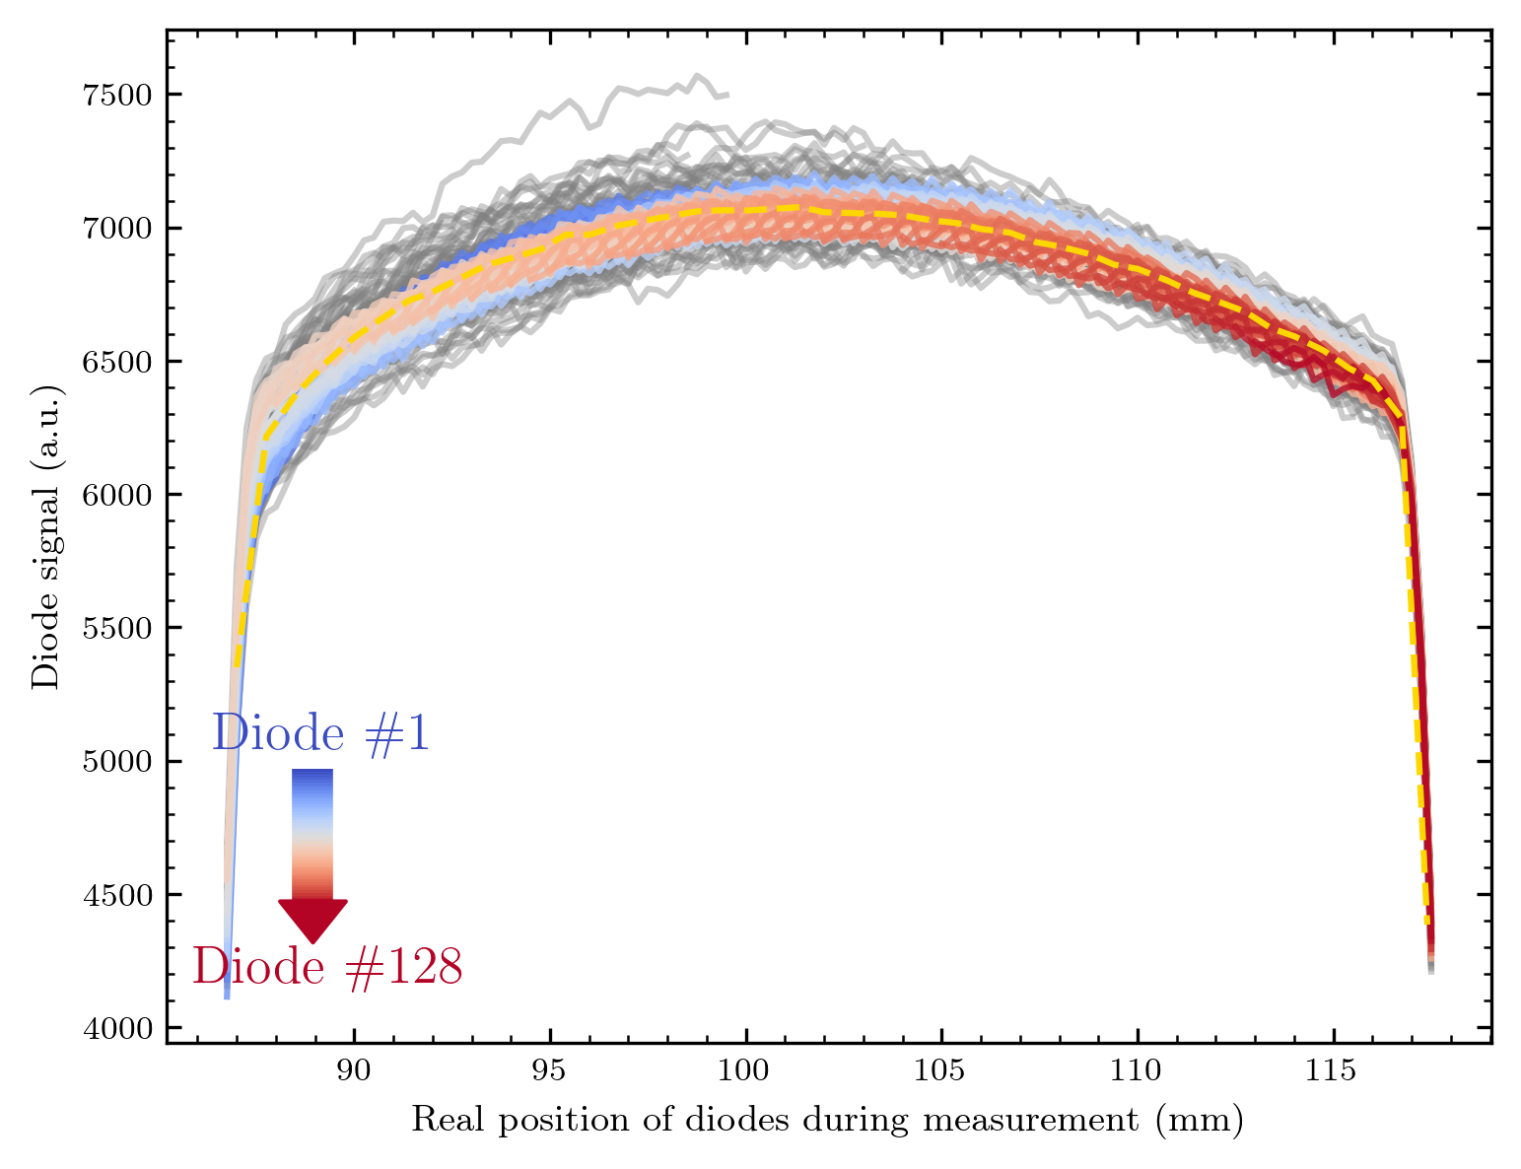
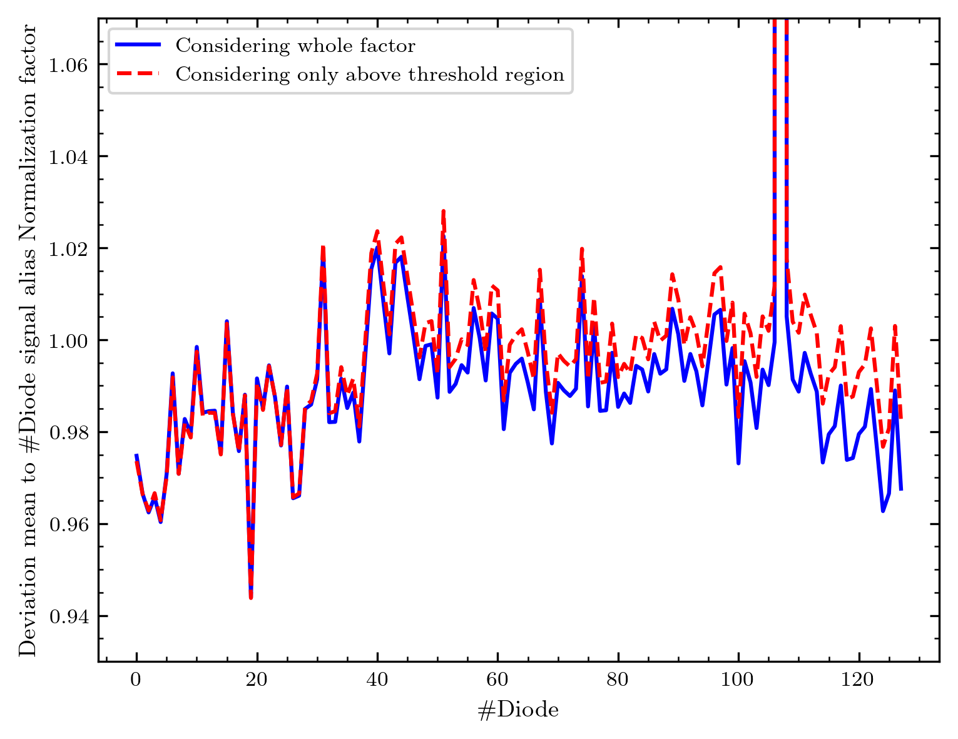
Shift back with factor

Slide 29
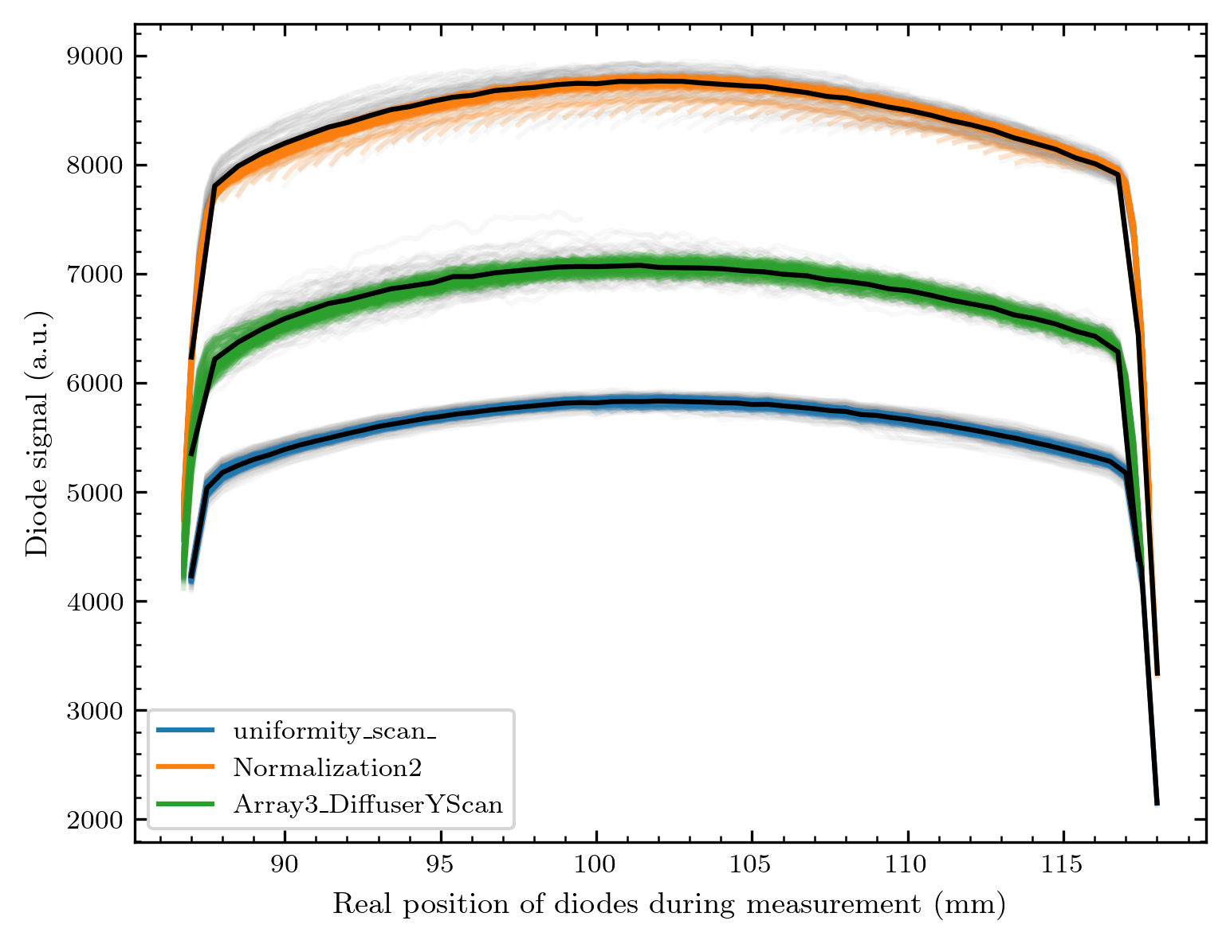
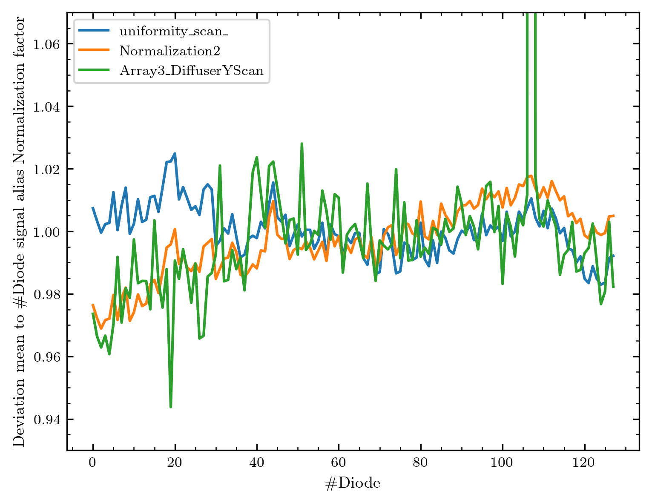
Comparison all 3 measurements
We are in a range of ~ 6 % homogeneity for the 2 arrays!

Slide 30
Now: Compare with older measurement!

Slide 31
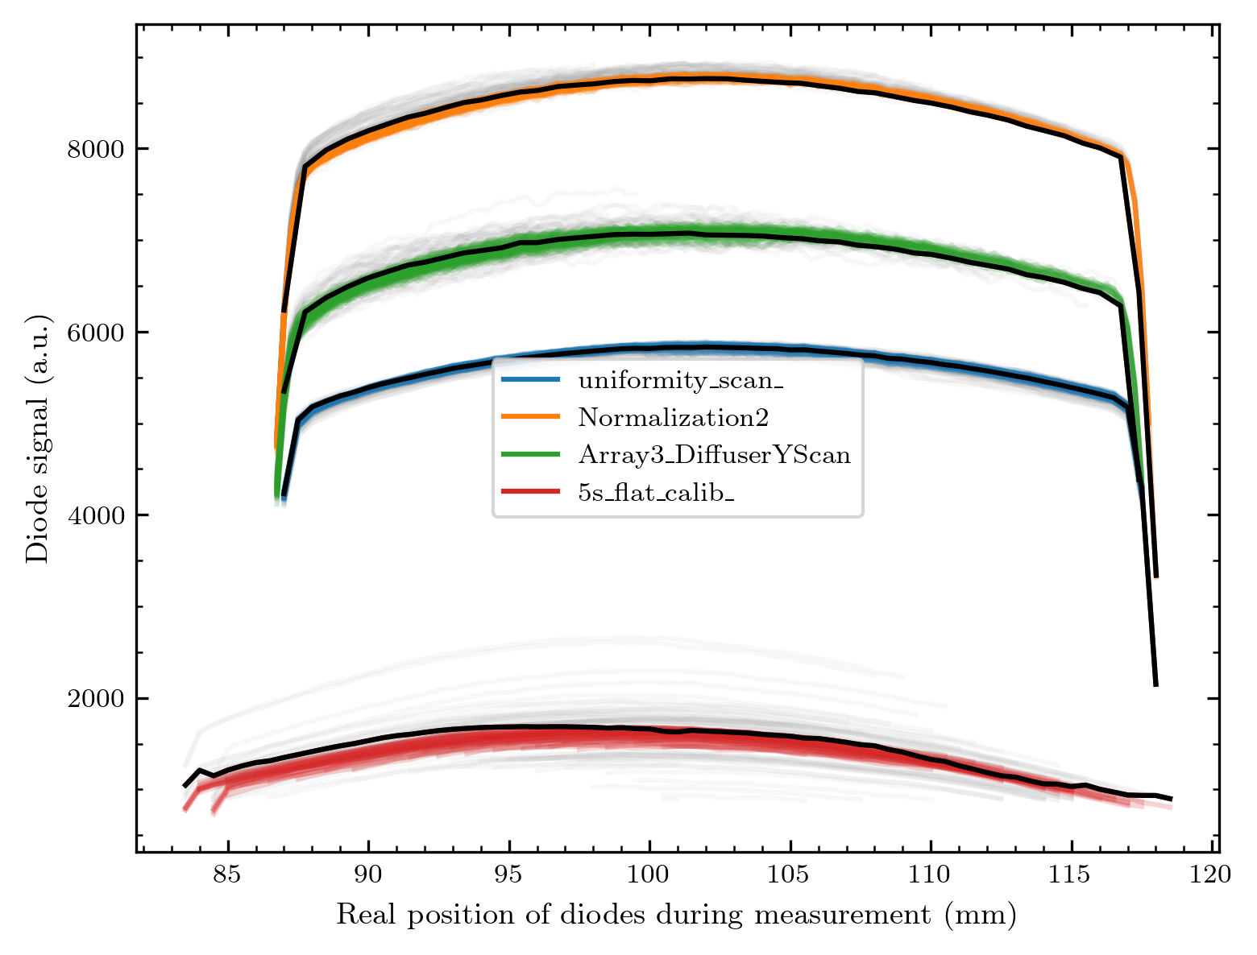
The response is less homogeneous than for the new arrays!
Also: The response is much lower.
From the logbook, these measurements had 1 nA
current, meaning the half of the 2 we had now.
And the setpoint voltages were different:
1.8 now, 2 V back then.

Slide 32
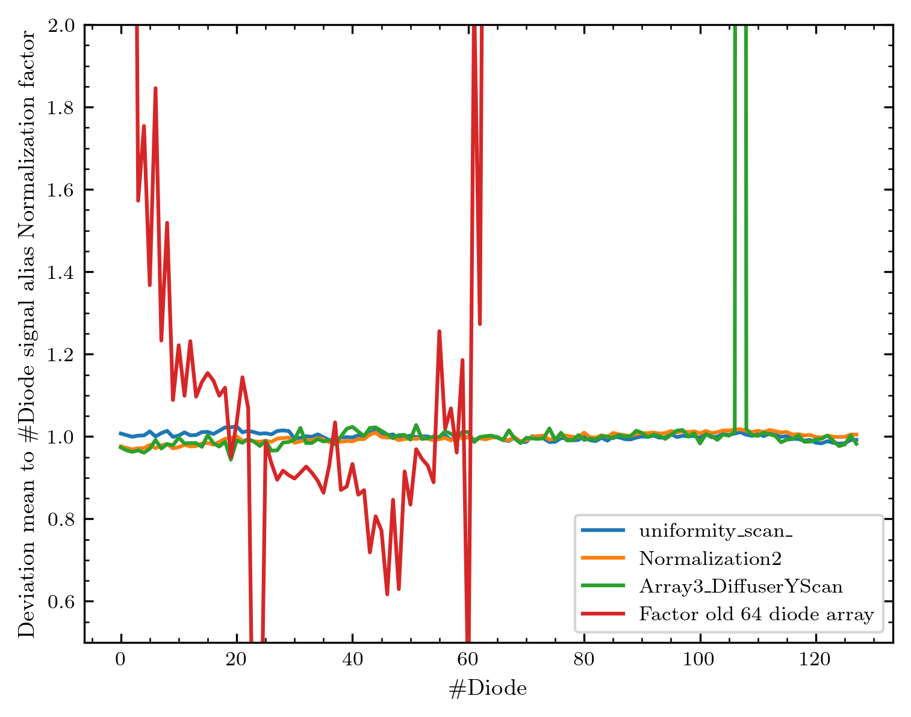
Comparing the factors
The homogeneity we reached now among one array
is ~ factor 20 times better than before!
Before: Factor from ~ 0.6 to ~ 1.8 -> 1.2 range
120 % deviation in response
Now: ~ 0.96 to ~ 1.02 -> 0.06 range
6 % deviation in response

Slide 33
Is the new normalisation necessary?
We talk about a signal correction in the percent region…
I add comparisons of maps without (left) and with (right) the new factor correction.

Slide 34
Round aperture

Slide 35
Logo

Slide 36
Misc

Slide 37
Beam Scan

Slide 38
Array 3 Logo

Slide 39
Array 3 Beam Scan

Slide 40
Maps
Only background subtracted
1st side measurement details + 1 map in real pixels (white space)
2nd side: Maps in pixel (filled)
3rd or 2nd side: Maps in contour

Slide 41
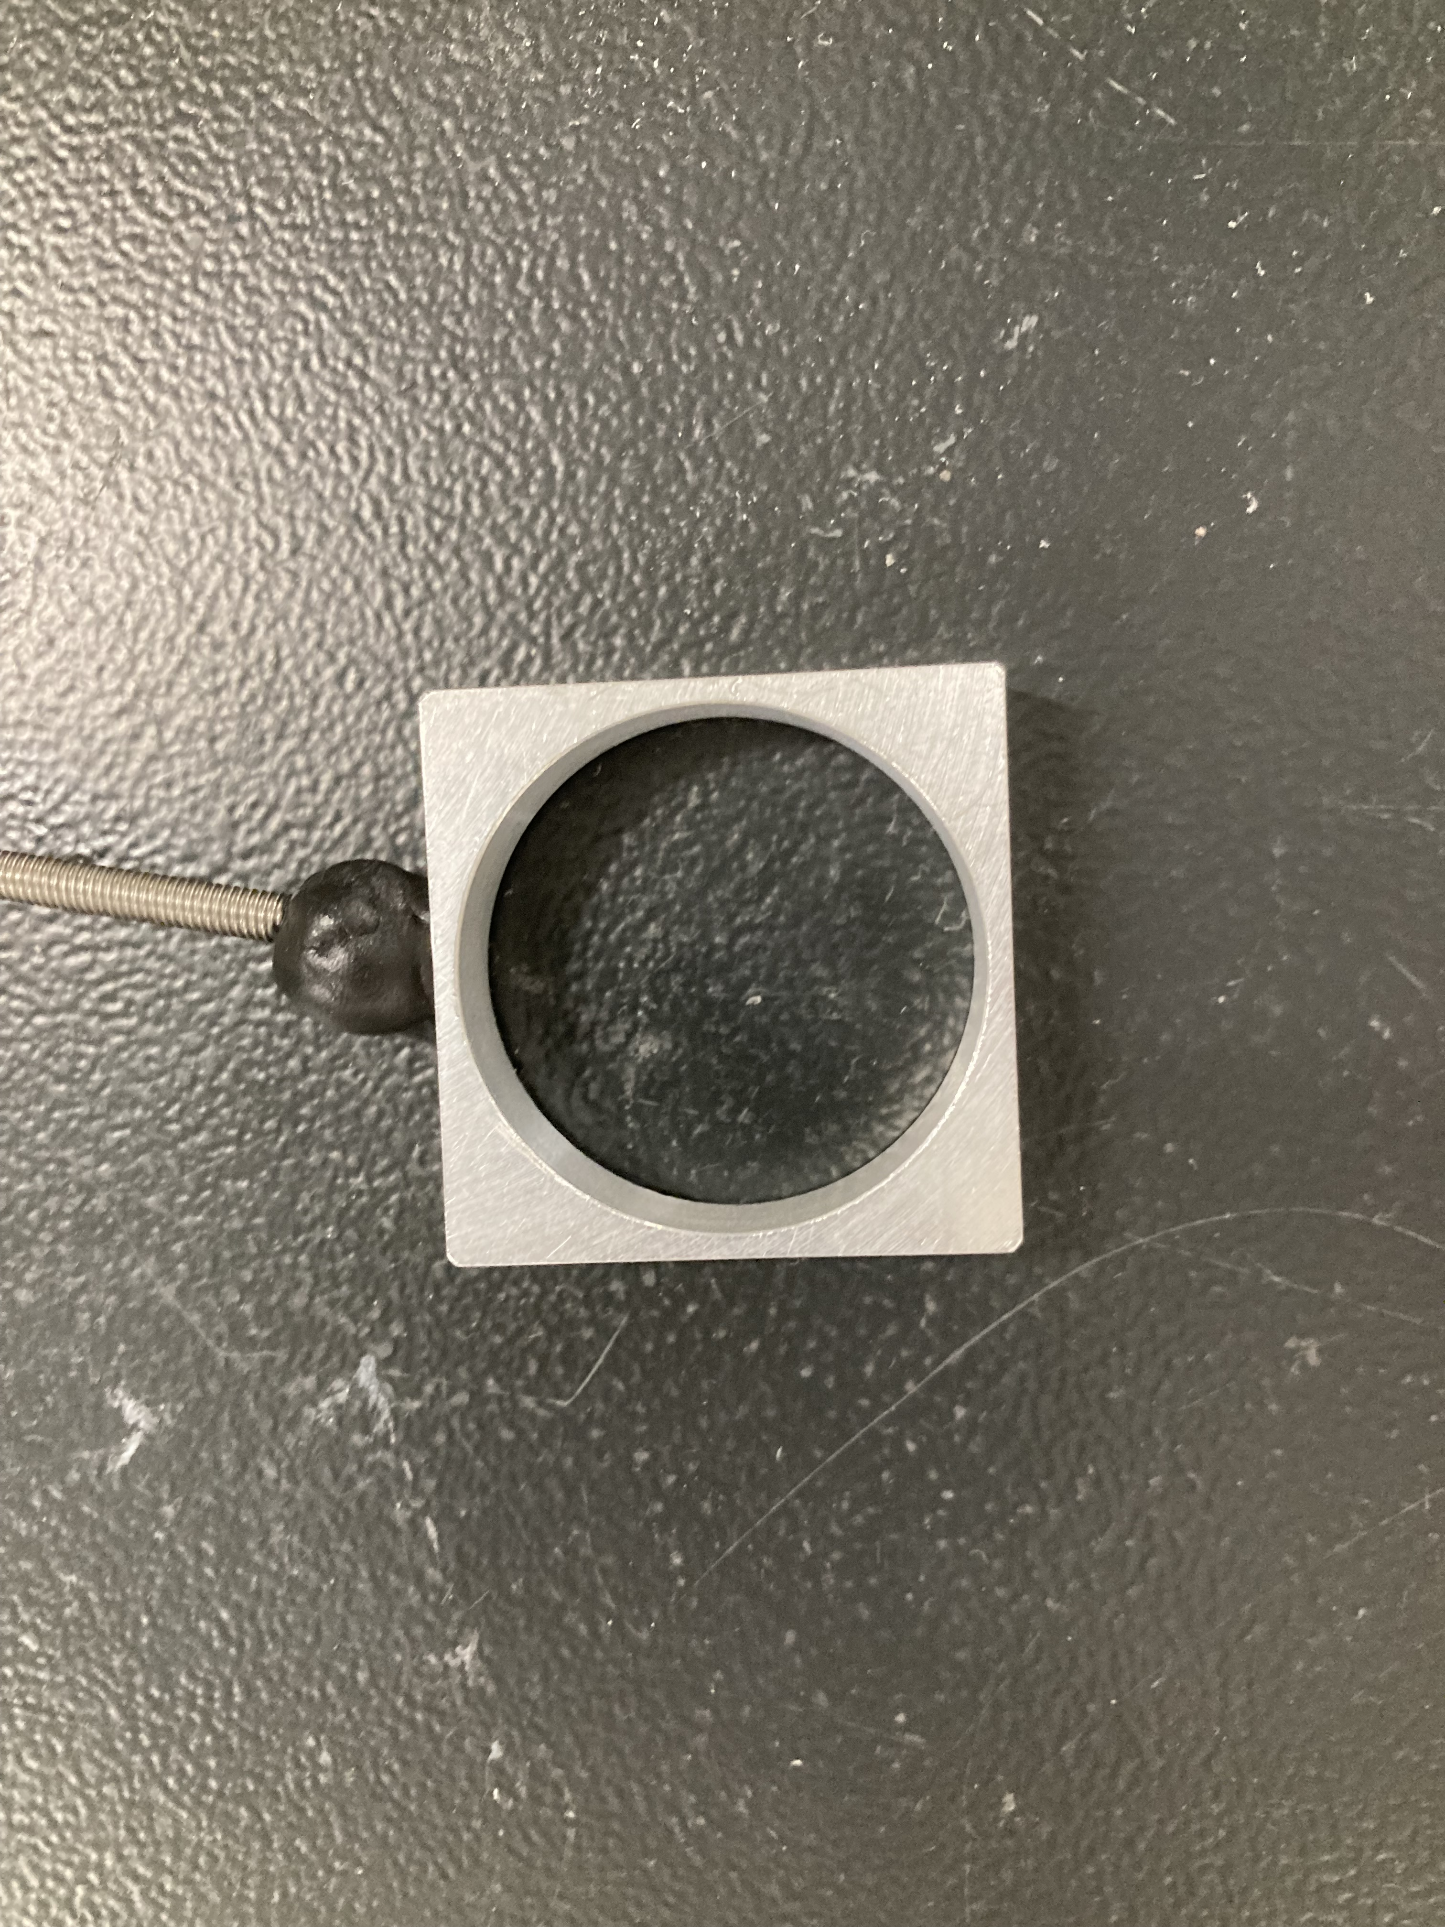
The round aperture
4 images (1 half out of the beam)
y = 40 mm: 2.43 nA -> 2.34 nA
y = 70 mm: 2.43 nA -> 2.36 nA
y = 85 mm: 2.41 nA -> 2.36 nA
y = 55 mm: 2.43 nA –> 2.38 nA

Slide 42
y = 40
y = 55
y = 70
y = 85

Slide 43
The Logo
4 images (over lunch)
y = 55 mm: 2.43 nA ->
y = 65 mm: ->
y = 75 mm: ->
y = 85 mm: –> 2.33 nA
Beam was stable enough to
do automatic measurement

Slide 45
The misc shape
Shadowing of the effectively smaller ~ 30 mm aperture
4 images (over lunch)
y = 55 mm: 2.43 nA ->
y = 65 mm: ->
y = 75 mm: ->
y = 85 mm: –> 2.33 nA
Beam was stable enough to
do automatic measurement

Slide 47
The beam shape without diffuser
We actually see a change in the beam between measurement 2 and 3 – this is a prove of our beam imaging ability. Maybe we can make some timelapse of the beam on the next measurement day!

Slide 48
Beam imaging without diffuser
3 images
y = 55 mm: 2.0 nA -> 1.91 nA
y = 70 mm: 2.0 nA -> 1.95 nA
y = 85 mm: 2.0 nA -> 1.97 nA
Currents at Faraday cup
No diffuser, thus = at sample (if not for the additional collimator in the beamline)

Slide 50
The Bragg peak (only 1 map, but y translated data)
Map at y = 70 mm
2.44 nA -> 2.44 nA
Y-scan
2.44 nA -> 2.44 nA

Slide 51
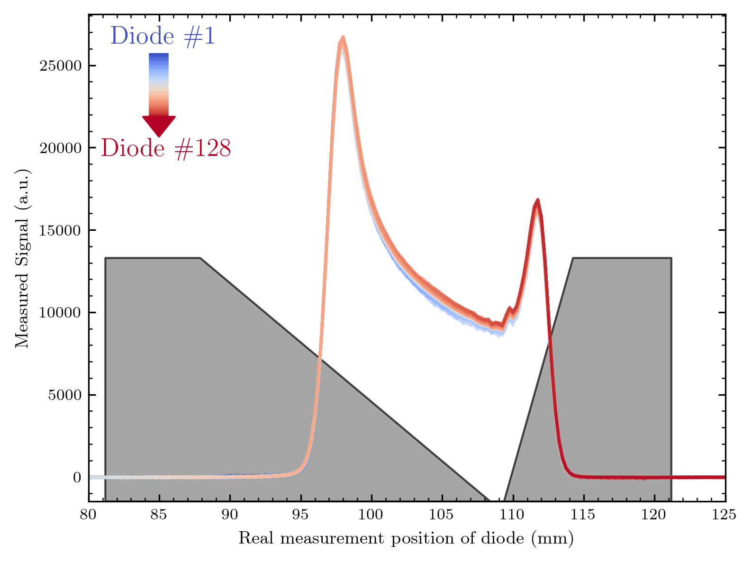

Slide 52
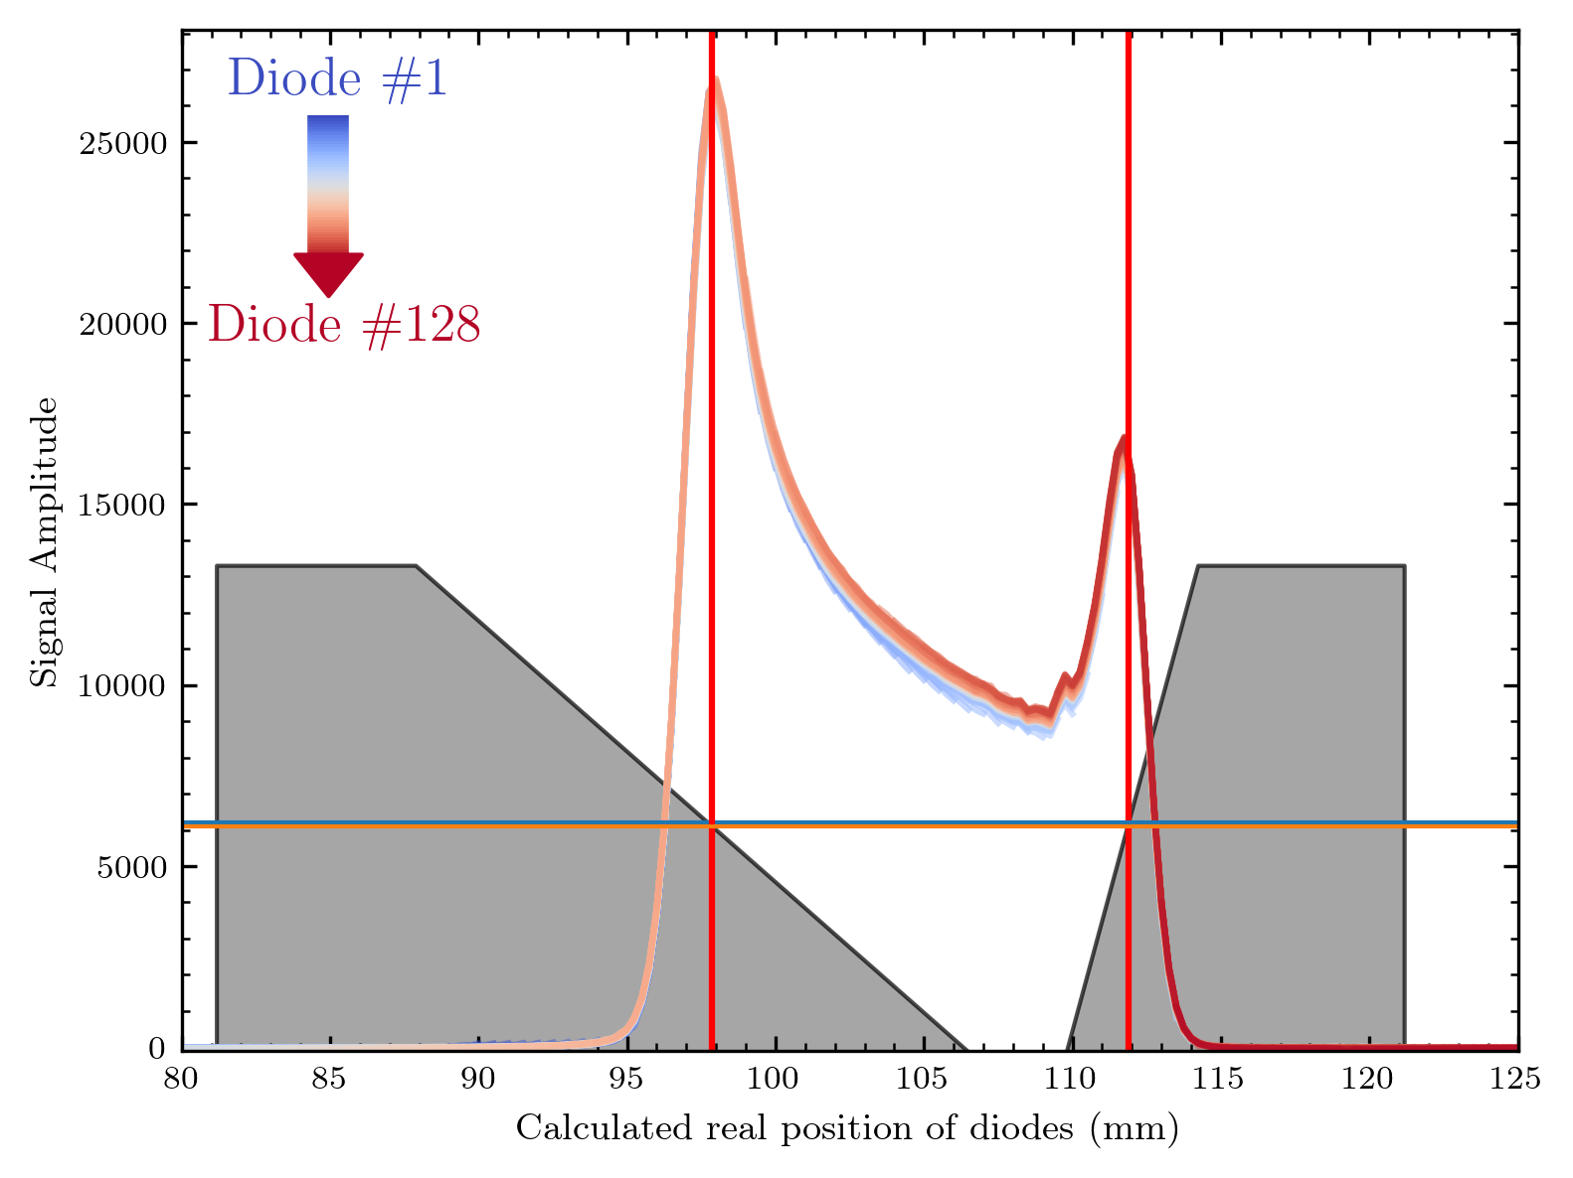
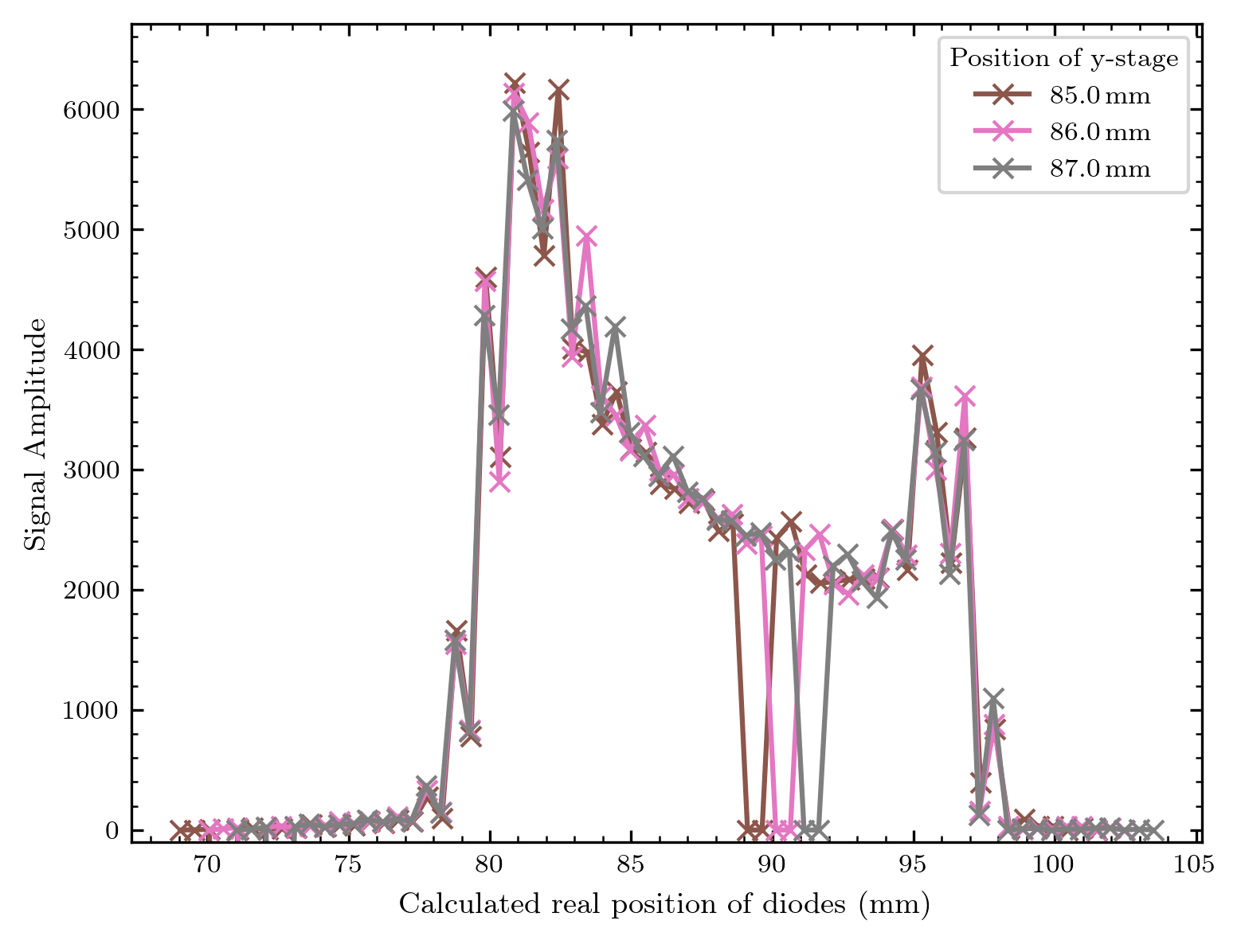
Comparison to previous measurements
without fanout on GaN wafer
with fanout on GaN wafer

Slide 53
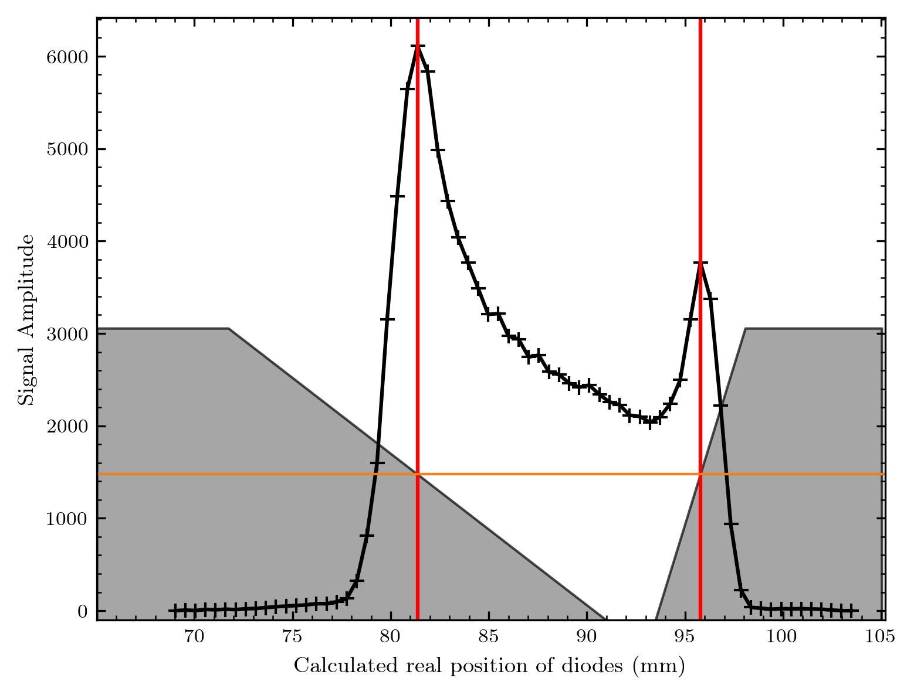
Trapezoid positioning
Latest measurements
Previous measurements
material thickness for max signal: ca. 5.3 mm
(Difference will probably arise from signal swap)
material thickness for max signal: ca. 5.15 mm

Slide 54
Smaller diodes = higher resolution?
SINGLE DIODE
SINGLE DIODE
500µm
500µm
10µm
400µm
500µm
400µm
20µm
250µm
170µm
400µm
30µm
10µm
200µm
200µm
“Array1“
“Array3“

Slide 55
Logo Array 3
This was the last measurement of the day, and with the correct set voltage of 1.8 V
Map at y=85
2.45 nA -> 2.42 nA

Slide 56
Smaller diodes 0.25 mm in scan direction + 0.25 mm steps
0.5 mm diodes + 0.5 mm steps
Looks successful, note that the signal is also nearly exactly halved

Slide 57
Beam Shape Array 3
Map at y = 85 mm
2.0 nA -> 1.9 nA
(without diffuser)
But with set voltage 1.0 V…

Slide 58
Smaller diodes 0.25 mm in scan direction + 0.25 mm steps
0.5 mm diodes + 0.5 mm steps
Quite some change of the beam within our measurement day!
Note that we cannot compare the signal here due to the different set voltages!

Slide 59
Comparison with gafchromic film
Only for diffuser since we haven‘t made a beam image…

Slide 60
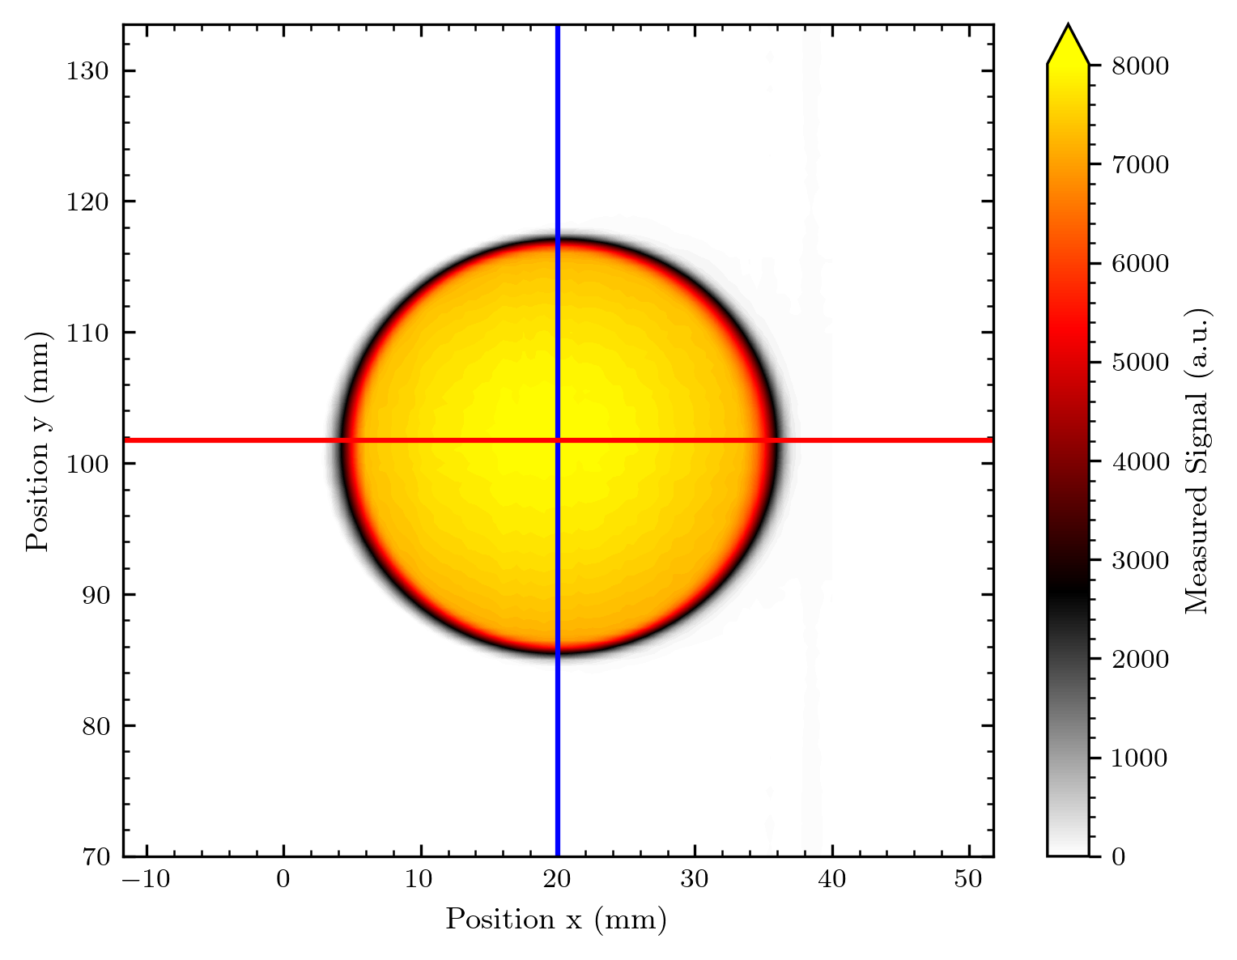
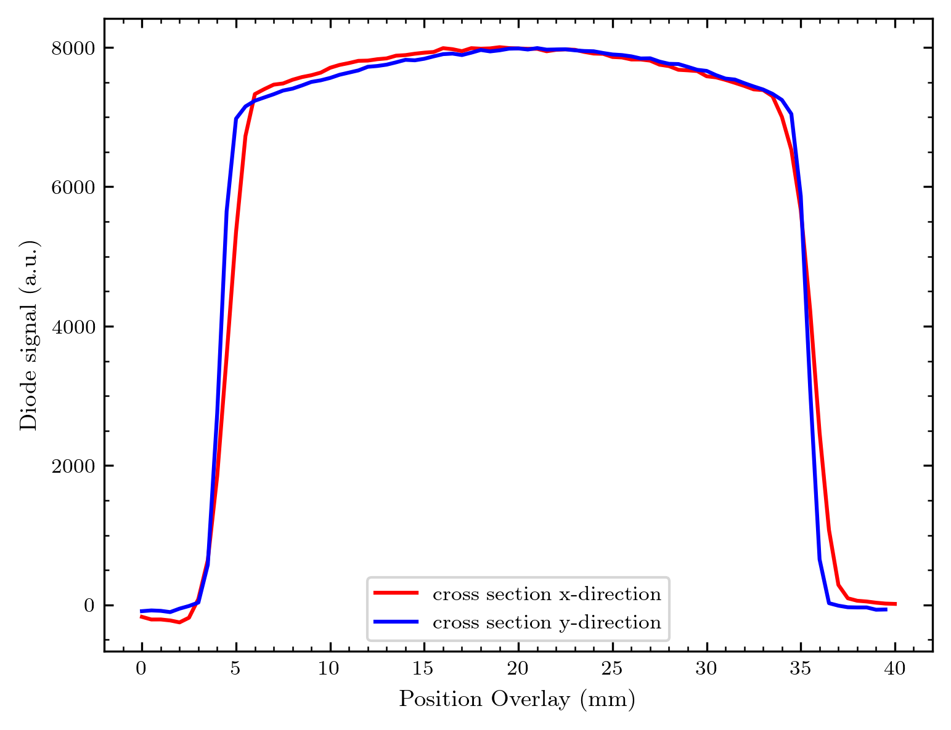
Comparison with diffuser Gafchromic

Slide 61
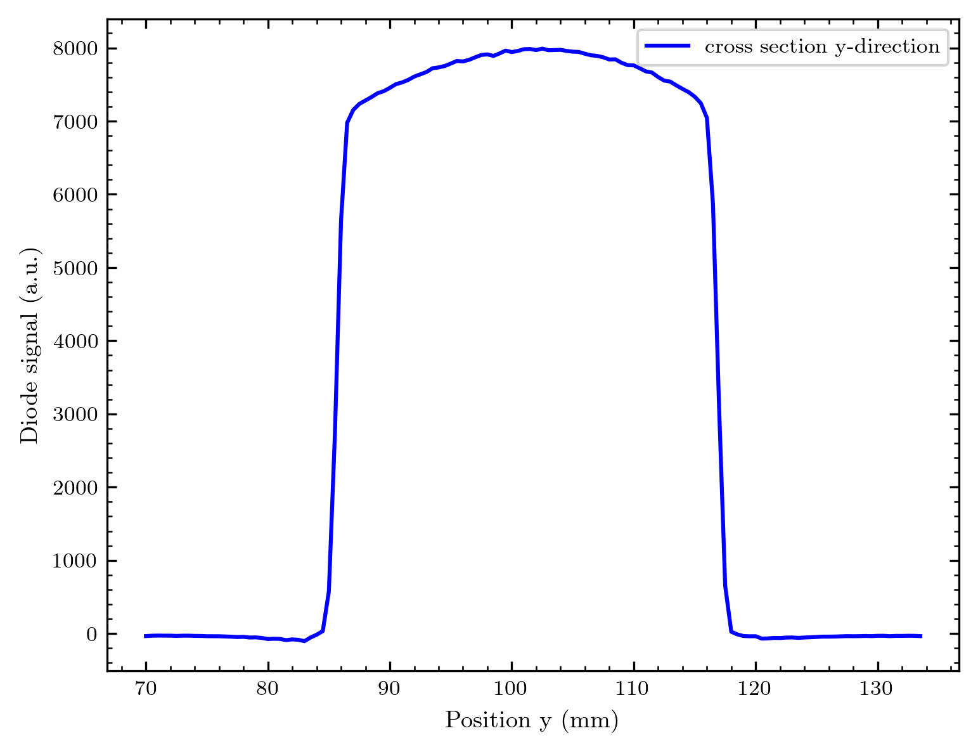
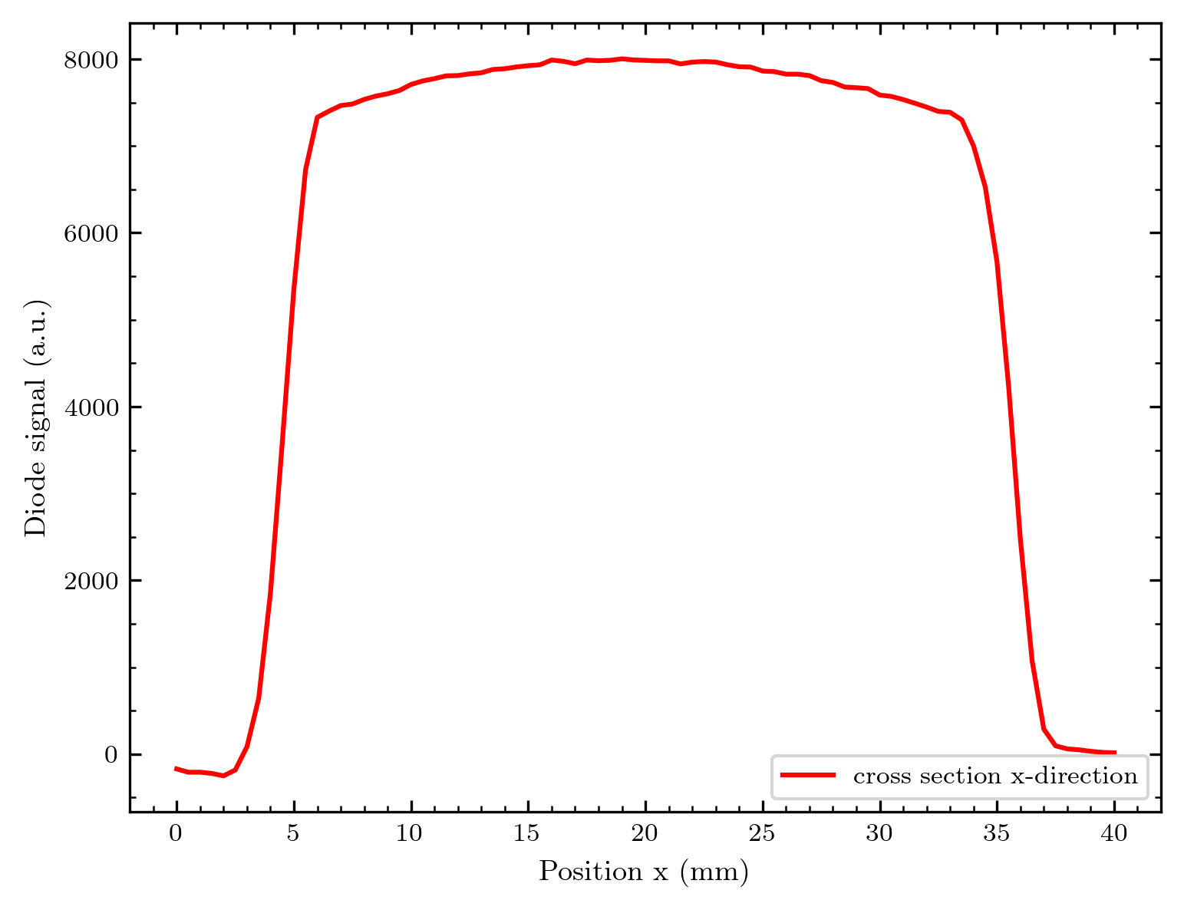
H
B
G
D
Looks reasonable, even though we see some curvature of the beam. The grey scale scan
looks more or less flat…
I might try to relate the greyscale and signal values based on scaling.

Slide 62
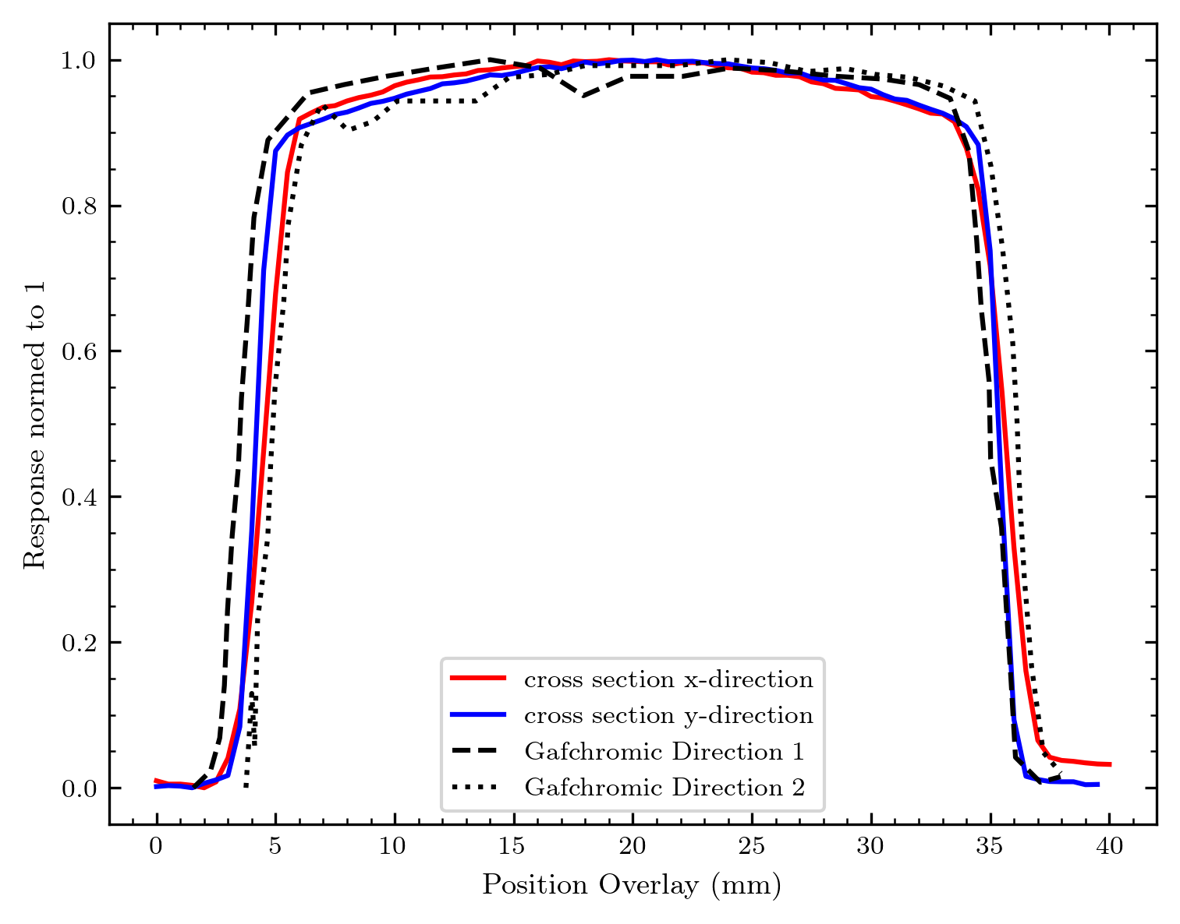
Norm all to 1 and align x-axes to get a quantitative comparison!
Data from Gafchromic extracted with online tool – points aligned by hand
(without investing several hours this at least gives a nice idea of the data curve)
Looks excellent, and it seems that our normed response can be compared to the response of the gafchromic!
H
B
G
D

Slide 63
Ideas for next measurements

Slide 64
What we have available
New matrix array:
11 x 11 diodes, 2 sizes

Slide 65
Wedge trapezoid of peak material

Slide 66
Next measurements
Beam imaging - maybe over a longer duration to generate a sort of “beam video“
More comparisons with Gafchromic! (Several beam shapes, diffuser, maybe also something else? – Bragg, misc, logo?)
New wedge shape + varied proton energy (max signal peak should move on the wedge)
Tests with the matrix arrays: Calibration (moving array through diffused beam), imaging

Slide 67
Standard for file naming
I think it might be a good idea to have a standard for the file naming. Currently, the naming is good – but some slight problems still exist.
My suggestion:
{#Number of measurement}_{Short name of measurement / object}_{Diffuser_thickness}_um_{Current at beam level!}_nA_{Set voltage of ams circuit in V}_x_{x pos of stage}_y_{y pos of stage}.csv
e.g.: 1_RoundAperture_200_um_2,43_nA_1,8_x_20_y_70.csv
Thus each measurement is distinct (due to the numbering) and we keep the most important values (easy to parse) in the file name.
Adapting this should be easy with Stéphanes Python script.

